Slide 1
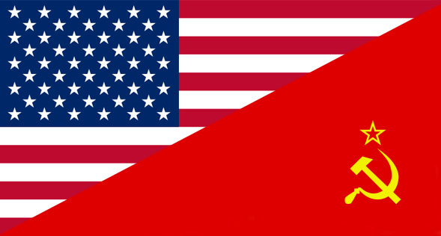
COLD WAR PART I

Slide 2
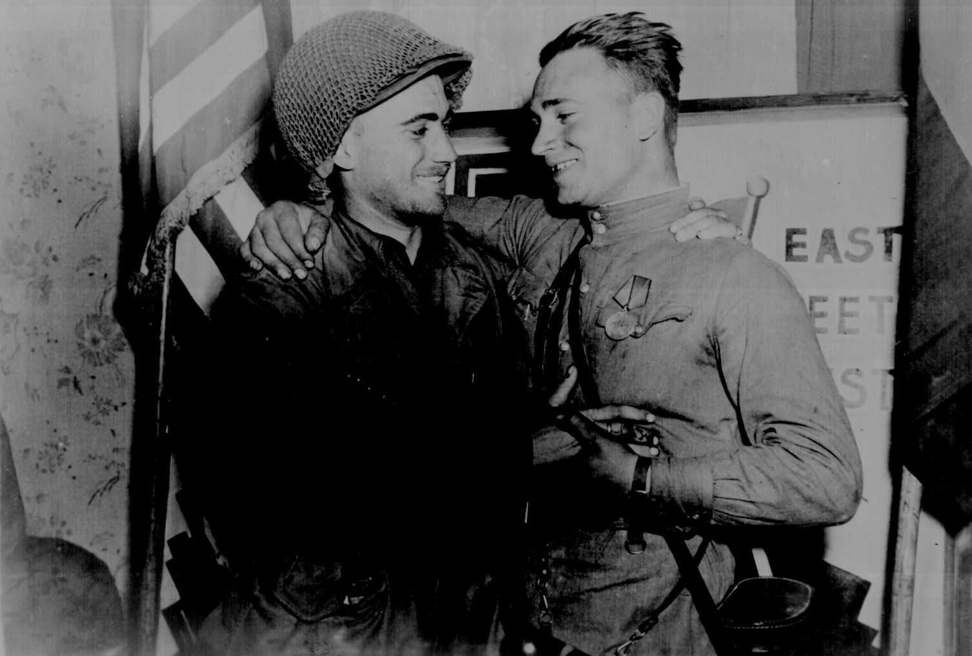

Slide 3
ORIGINS
Conflicting postwar goals:
Soviets: wanted to rebuild Europe in ways that protected its interests
Create satellite nations to protect the borders of Russia
U.S.: wanted to bring democracy & economic opportunity

Slide 4
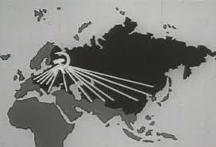

Slide 5
United Nations
New international peacekeeping organization created to replace the old League of Nations
Members vow to settle differences peacefully & prevent wars

Slide 6
Potsdam Conference**
Truman’s first meeting with Joseph Stalin in July 1945
Met to discuss the future of Eastern Europe
Stalin promises free elections (democracy) but quickly breaks this promise

Slide 7
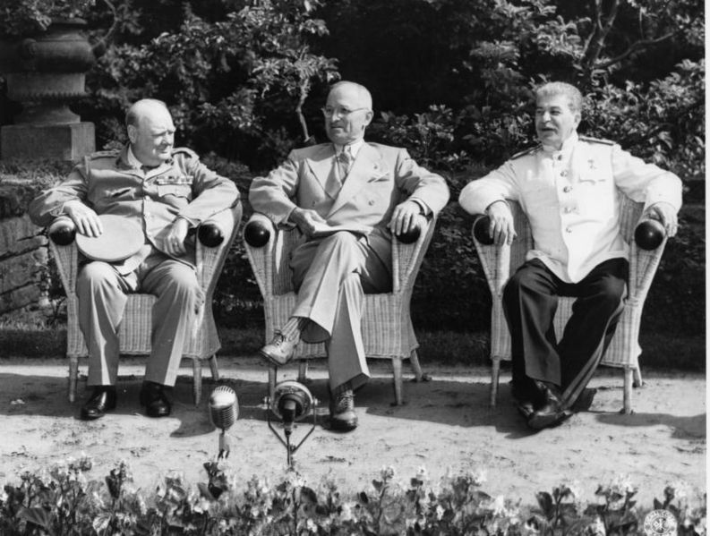

Slide 8
Iron Curtain
“From Stettin in the Baltic to Trieste in the Adriatic an iron curtain has descended across the Continent.”
Winston Churchill speech at Fulton, Missouri in 1946

Slide 9
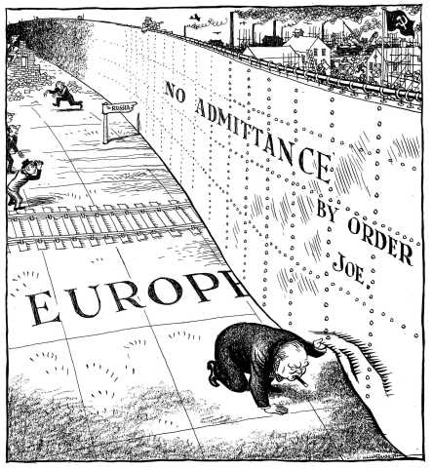

Slide 10
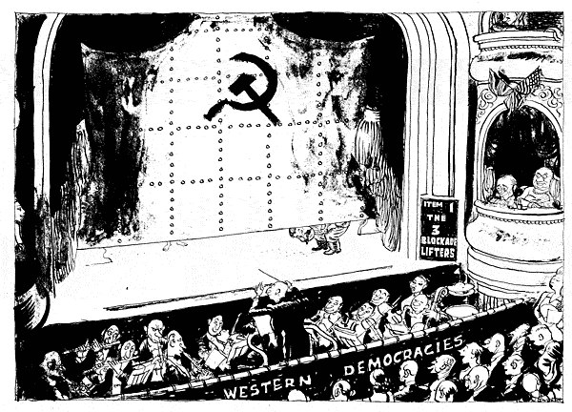

Slide 11
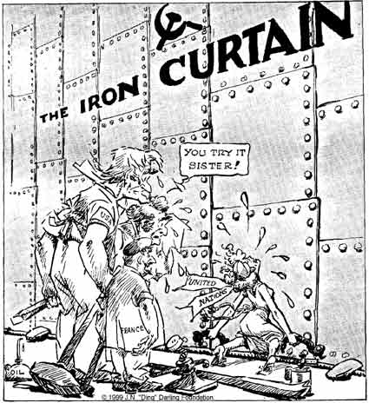

Slide 12
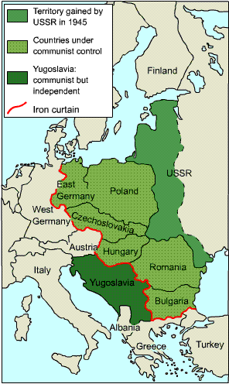

Slide 13
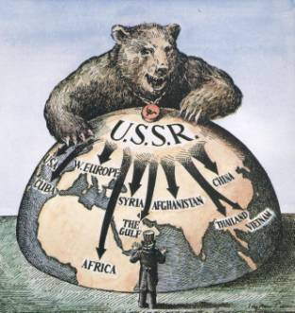
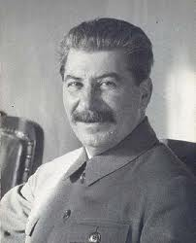
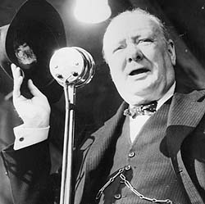
Cominform
Soviets establish this to direct Communist parties throughout the world
Churchill calls on America to keep any more countries from falling into Soviet grasp

Slide 14
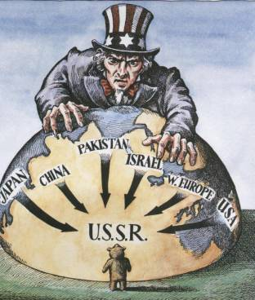
Containment Policy
Policy of the U.S. to “contain” communism, or stop the spread

Slide 15
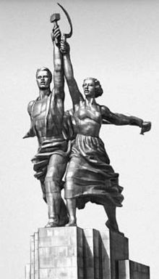
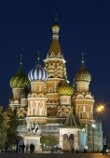

Slide 16
Term “Cold War”
Coined by Walter Lippman
Described the icy rivalry & state of war that existed that did not involve bloodshed

Slide 17
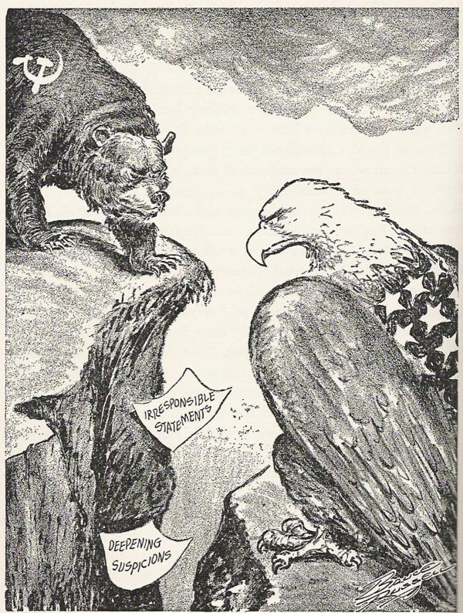

Slide 18
Truman Doctrine
Claimed that the U.S. must help countries resisting communism
“I believe that it must be the policy of the United States to support free peoples who are resisting attempted subjugation by armed minorities or outside pressures…” ~Truman 1947
Greece & Turkey receive aid

Slide 19
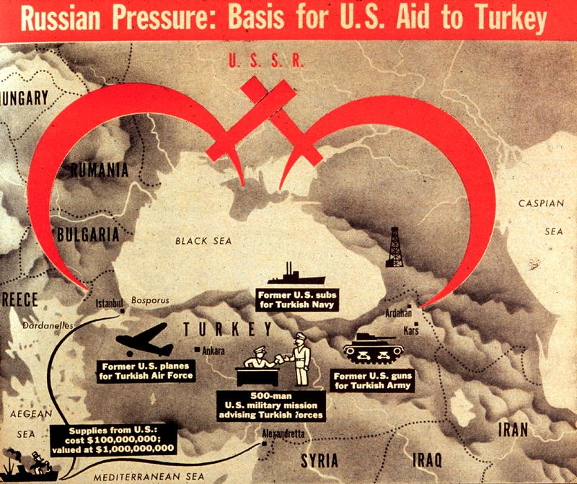

Slide 20
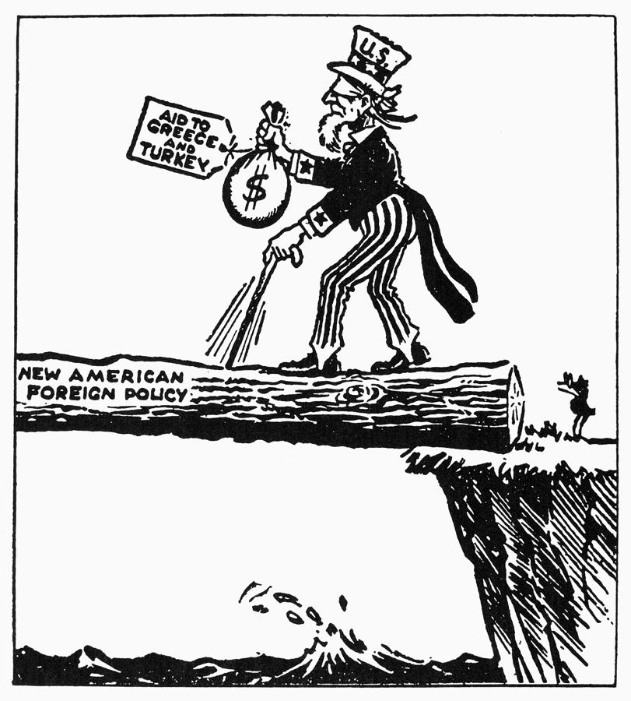

Slide 21
Marshall Plan
Plan for the U.S. to help war-torn nations in Europe to create democracies & achieve economic recovery
Give them financial aid ($) to rebuild & resist communism
***Also provides consumers for American goods

Slide 22
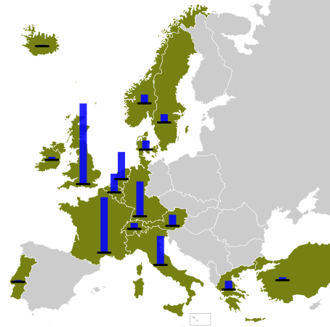
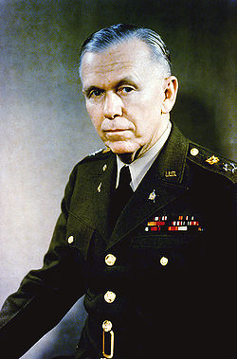
Proposed by Secretary of State George Marshall in 1947
17 nations join

Slide 23
Germany
Divided into 4 sections
U.S., France, Great Britain, & Soviets all controlled a part
Capital city of Berlin was also divided into 4 sections
Berlin lay in the Soviet sector

Slide 24
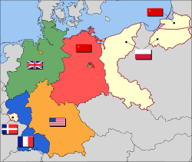

Slide 25
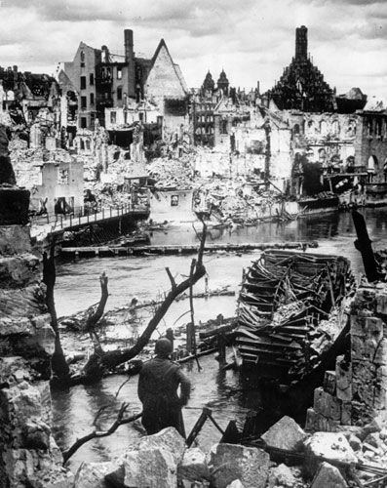
Nuremburg, Germany

Slide 26
Berlin Blockade
June 1948:
Soviets block Allied access to West Berlin
To avoid war, Allied airlift supplies in to the city of Berlin
Berlin Airlift
Lasted 15 months
Over 200,000 flights made to deliver supplies
By May 1949, the Soviets backed down

Slide 27
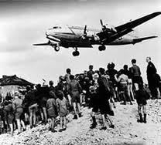
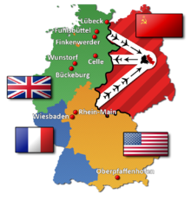

Slide 28
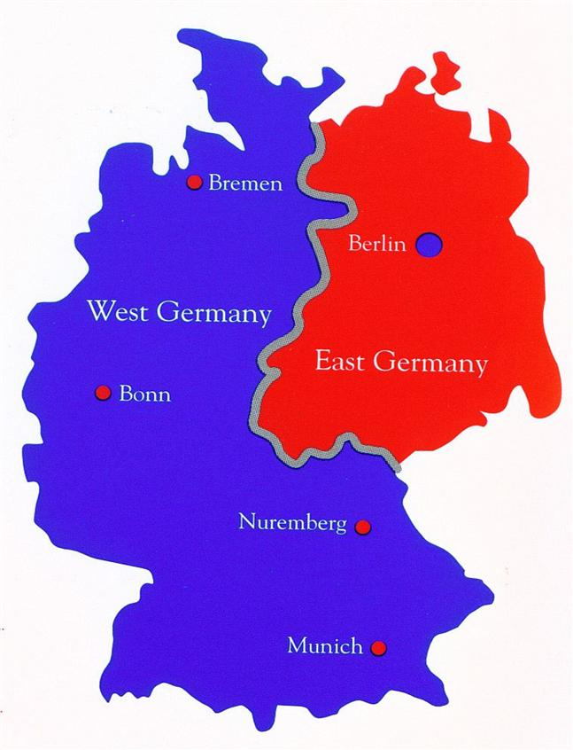
1949:
Western Allies (Britain, France, & U.S.) join their sectors to create the Federal Republic of Germany or West Germany
The Soviets refused to join their sector & declared their portion to be the German Democratic Republic or East Germany
The city of Berlin likewise
became divided into
West & East Berlin

Slide 29
NATO
North Atlantic Treaty Organization
1949
Western Europe defense alliance
U.S., Canada, Britain, France, Belgium, Denmark, Italy, etc.
“An armed attack against one of them shall be considered an attack against them all.”
Known as Collective Security

Slide 30
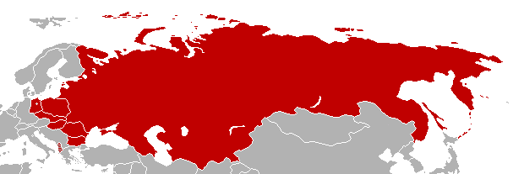
Warsaw Pact
Soviet response to the formation of NATO
Included Soviet Union & eastern European countries (satellite nations)

Slide 31
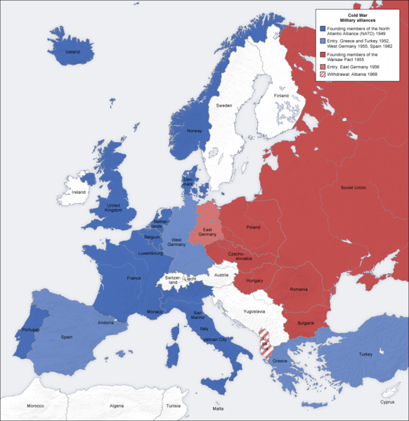

Slide 32
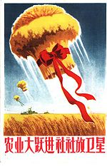
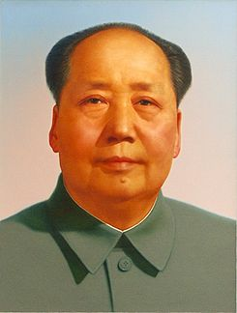
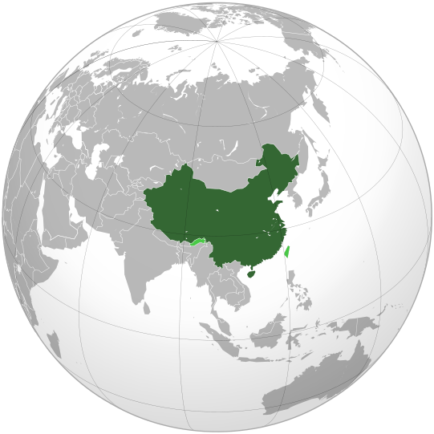
1949: China falls to Communism
Mao Tse-tung = leader

Slide 33
Soviet Atomic Threat
1949: Soviets first successfully test an atomic bomb
In response, Truman approves the development of a hydrogen, or thermonuclear, bomb in 1950
The nuclear arms race begins

Slide 34
Federal Civil Defense Administration
Tell Americans how to survive a nuclear attack
“duck & cover” drills practiced
Bomb shelters or fallout shelters placed in courthouses or other public places

Slide 35
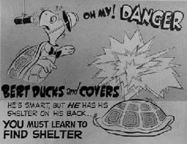

Slide 36
Second Red Scare
1949: China falls to communism
People’s Republic of China declared
Mao Zedong leader
U.S. refuses to recognize the government, calls Taiwan the official Chinese gov.

Slide 37
Loyalty Program
1947
Federal employees investigated for communist influences
People were brought before a Loyalty Review Board
Only a few hundred removed from their jobs

Slide 38
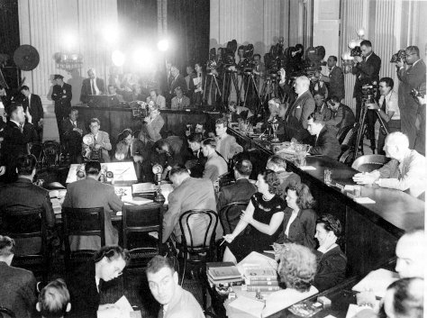
HUAC
House Un-American Activities Committee
Investigated communist infiltration of gov’t agencies & the Hollywood movie industry

Slide 39
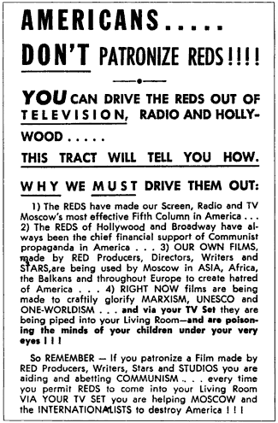

Slide 40
Hollywood Ten
1947
Hollywood actors, writers, directors, & producers testify before HUAC
10 refused to answer questions
Invoked the 5th Amendment
Cited for contempt of Congress & served jail terms
6 months to a year
Hollywood blacklist
List of possible communists that should not be hired

Slide 41
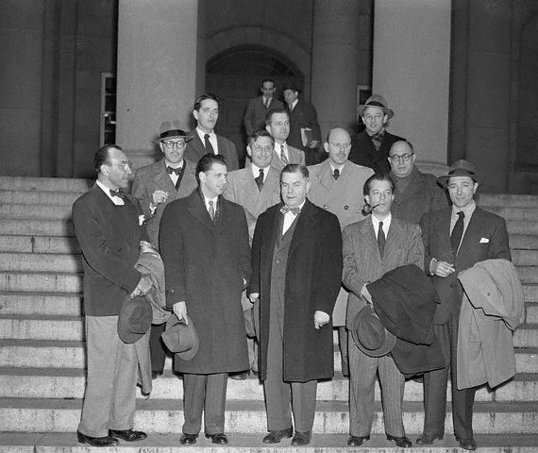
Waiting to be fingerprinted…

Slide 42
McCarran-Walter Act
Limited immigration
Set up a quota system
Discriminated against immigrants from Asia & Southern & Central Europe b/c of possible communist influences

Slide 43
Korean War
1945
Korea was divided at the 38th parallel
Soviets in the North
U.S. in the South
June 1950: War breaks out when North Korea invaded South Korea

Slide 44
United Nations sends troops under General Douglas McArthur
When they push North Koreans back over the 38th parallel, they pursue them in an attempt to unite the two countries
Chinese send troops to fight
McArthur & his troops are soon pushed back to the 38th parallel
Stalemate develops

Slide 45
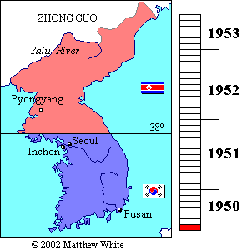

Slide 46
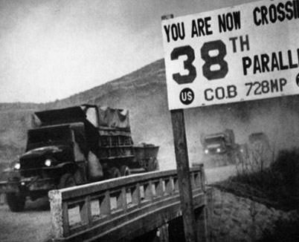

Slide 47
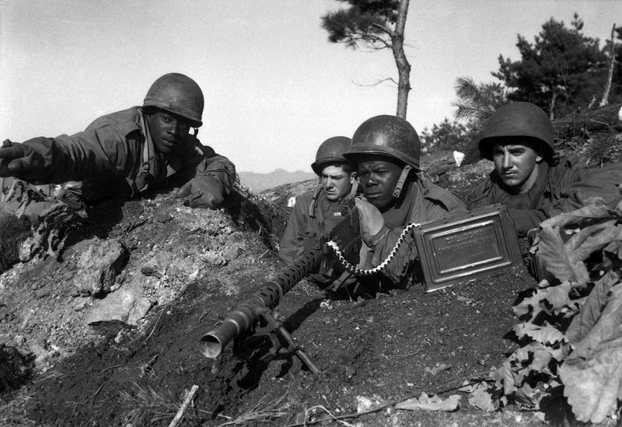

Slide 48
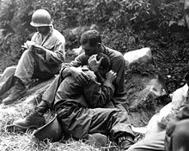

Slide 49
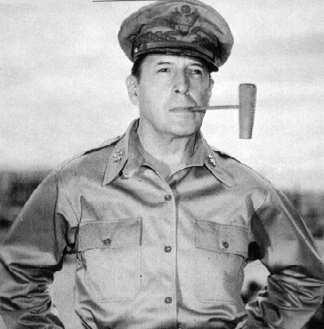
McArthur publically denounces Truman’s handling of the war
He is fired for insubordination
1953: truce signed
55,000 troops are killed
First desegregated War
Truman desegregated the
armed forces in 1948
Silent Generation
Did not challenge societal standards

Slide 50
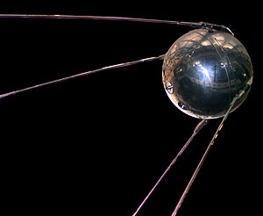
Space Race
1957: Soviets launch the first satellite into space
Sputnik
Frightens U.S. b/c:
Soviets were ahead technologically
Soviets could hit U.S. with a missile from Russia
ICBM technology (Intercontinental Ballistic
Missile Tech.)

Slide 51
NASA
National Aeronautics & Space Administration
Established by Eisenhower
Ultimate goal = land a man on the moon
Real mission was to catch up in the race for technology
Internet, computers, satellites, microwave, etc.

Slide 52
NDEA (National Defense Education Act)
1958
Gave $ to college students in the areas of science & language
Apollo Space Program
Lasted from 1963-1972
Apollo 11 on July 20, 1969 first success
Neil Armstrong & Buzz Aldrin first to walk on the moon
U.S. had “won” the space race

Slide 53
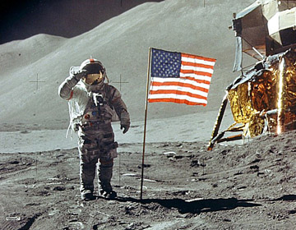
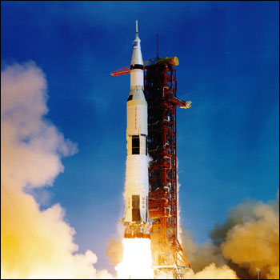

Slide 54
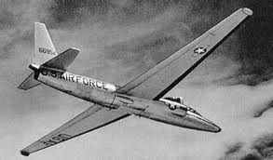
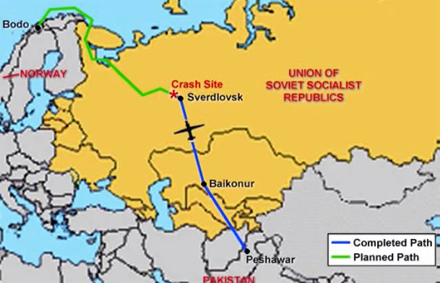
U-2 Incident
U.S. spy plane shot down over Russia in 1960
Embarrassment to Eisenhower & U.S.

Slide 55
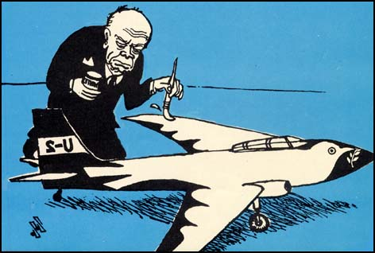
Soviet Cartoon

Slide 56
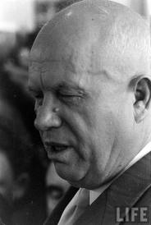
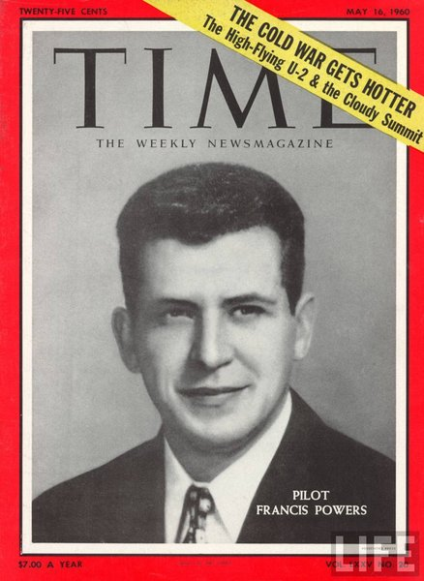

Slide 57
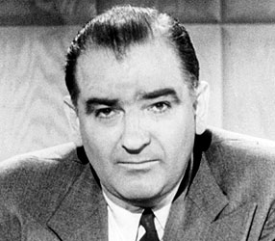
McCarthyism
Modern-day witch hunt to find Communists
Joseph McCarthy alleged that there were 205 Communists working the State Department
Readjusted number to 57
Accused George Marshall
Early 1954, claims the military is full of Communists

Slide 58
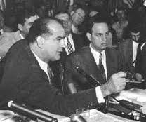
Army-McCarthy hearings
Televised April to June 1954
People realized that it was ridiculous
McCarthy lost support

Slide 59
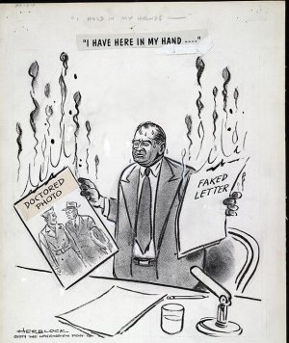

Slide 60
Domino Theory
Belief that if one country fell to communism, neighboring countries would fall to communism as well
Gets us involved in Vietnam

Slide 61
Southwest Asia (Middle East)
May 1948: Jews in Palestine proclaim the country of Israel
Conflict erupts
U.S. supported Israel
Soviets supported Arab nations

Slide 62
Eisenhower Doctrine
U.S. would support Middle Eastern nations resisting communism
Directly due to the amount of oil in the region
Led to our increasing involvement in the region as the rise of suburbs and increased use of automobiles occurs

Slide 63
Brinkmanship
Risking war to protect national interests
Becomes the most common way for nations with nuclear capabilities to behave in the post-WWII era

Slide 64
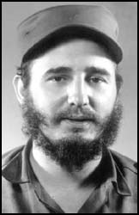
Latin America
1947: Rio Pact
Defense alliance between U.S. & 18 nations in Latin America
1954: CIA helps to overthrow Guatemalan gov’t
1959:
Fidel Castro overthrows corrupt dictator Fulgencio Batista in Cuba
Cuba becomes Communist
U.S. cuts ties with the country
Institutes an economic embargo

Slide 65
Bay of Pigs Invasion***
CIA trained Cuban nationalists to go in & take out Fidel Castro with U.S. air & naval support
Took place April 17, 1961
Complete disaster
Embarrassment for the U.S.

Slide 68
Cuban Missile Crisis***
Oct. 16, 1962:
Spy photos reveal the Soviets were building missile base in Cuba (90 miles off the U.S. coast)
U.S. military on full alert
Naval quarantine placed around the island

Slide 69
Oct. 26, 1962:
Khrushchev promised in a letter to remove the missiles
For thirteen days, the two countries were on the brink of nuclear war

Slide 74
Mutually Assured Destruction
MAD
The knowledge that if one country attacked the other, they would be wiped out as well
Reason why neither U.S. or Russia was willing to use nuclear weapons

Slide 76
Operation Plumbbob
1957 tests conducted in Nevada using soldiers

Slide 77
Limited Test Ban Treaty
1963
Banned the testing of nuclear weapons above ground

Slide 79
Alliance for Progress
1961
Promote “peaceful” revolutions in developing countries
U.S. trying to get nations to ally with them instead of the Soviets
Focus:
Latin America
Asia
Africa

Slide 80
Peace Corps
1961
Send volunteers to developing countries
Educators
Health workers
Technicians

Slide 81
Lyndon B. Johnson
1965:
Sent marines into the Dominican Republic

Slide 82
Berlin Crisis
Soviets wanted the division of Germany & Berlin to be permanent & stop the flow of people from East to West
Aug. 1961:
Soviets build the Berlin Wall
Ultimate symbol of the Cold War

Slide 84
Vietnam

Slide 85
For 2,000 years they struggle against China
In 1800, they become a colony of France
French Indochina
Resist under communist leader Ho Chi Minh
By 1954, they were defeating the French
A conference is called & the country is split at the 17th Parallel
French leave after their defeat at Dien Bien Phu
U.S. send $ to the South Vietnamese gov’t under the Truman Doctrine

Slide 87
1961
JFK sends military advisors
Viet Cong take over more & more territory

Slide 88
1964
Johnson reports that the North Vietnamese had fired on two American ships in the Gulf of Tonkin
Asks Congress for permission to bomb North Vietnam
Congress responds with the Gulf of Tonkin Resolution
Gives the President its war-making powers

Slide 89
.

Slide 90
Agent Orange

Slide 91
Napalm

Slide 92
Tet Offensive 1968
North Vietnamese offensive
Public opinion turned against the war
War was televised
Walter Cronkite criticized U.S. involvement

Slide 94
Nixon
Negotiated peace in 1973
1975: South Vietnam fell to North Vietnam
58, 000 killed

