Slide 1
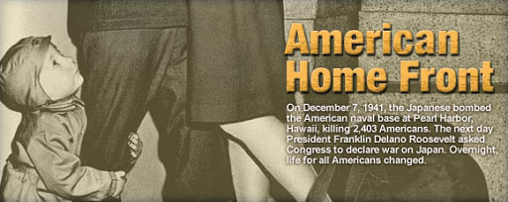
WWII: The Homefront
The Greatest Generation: Part 2
MAAP USH 7 Paula Childs

Slide 2
MAAP Standards
USH7 6. Describe the mobilization of various industries to meet war needs. 8. Trace the way in which the US government took control of the economy through rationing, price controls, limitations on labor unions, the sale of bonds and wage controls. 9. Identify ways in which the roles of women and minorities changed during the war.

Slide 3
Bell Ringer

Slide 4
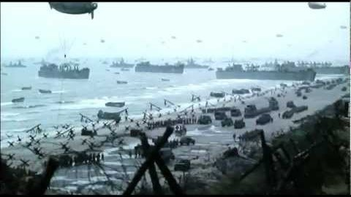
Notes:
The creator of the movie clip has documented several battles with the prayer by FDR. In his prayer FDR is asking God for several things. List four.

Slide 5
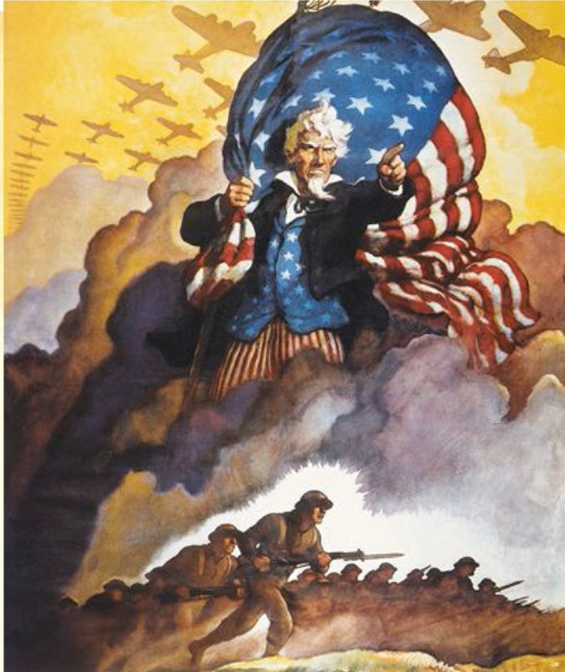
Preparing for War:
The Homefront
  America needed time to retool itself for war
  U.S. needed food and munitions to its allies
National unity was strong after Pearl Harbor
Japanese Americans- questions of espionage-Japanese internment
War changed American’s mood
  -The era of the New Deal was over
  -U.S. government now put emphasis on mobilizing for war.
Notes:
Have Students Read the Decision of Korematsu v. U.S.

Slide 6
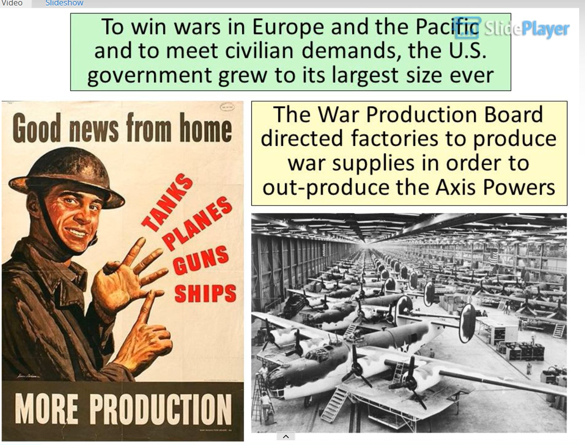

Slide 7
Building the War Machine
American economy reformed
  War Production Board (WPB)
    Organized nation’s industrial /agricultural output
  The Office of Price Administration (OPA)
    Rationing, limit inflation / shortages
  The National War Labor Board (NWLB)
    Imposed ceilings on wage increases
Labor conditions
  Labor union membership increased
  The Smith-Connally Anti-Strike Act (June, 1943)
    Feds could limit strikes

Slide 8
Funding the War
Americans had to make sacrifices in order to conserve materials to help factories make products needed for the war.
During the war, much of the consumer goods were limited to only what was necessary for survival. This is called Rationing. The government put wartime rationing on everything from sugar, coffee, meat, butter, shoes, to gasoline.
Scrap Drives → volunteers collected spare rubber, tin, aluminum and steel
Victory Gardens → government encouraged people to grow their own fruits and vegetables
Government issued war bonds to help pay for the war.
Buying bonds = lending the government money

Slide 9
Propaganda Activity

Slide 10
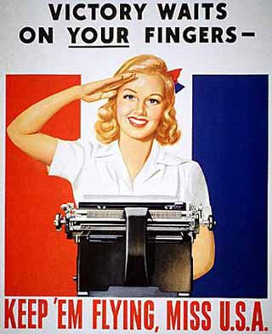
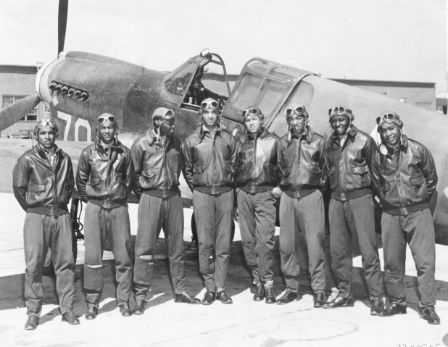
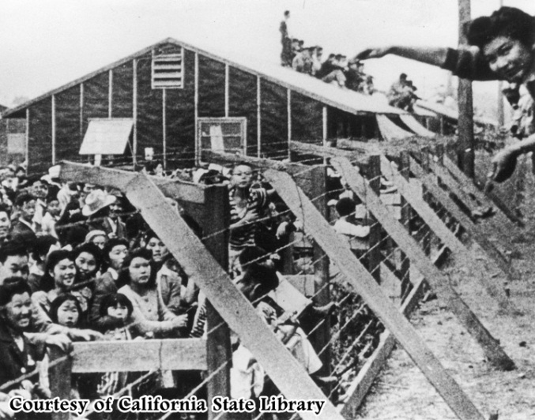
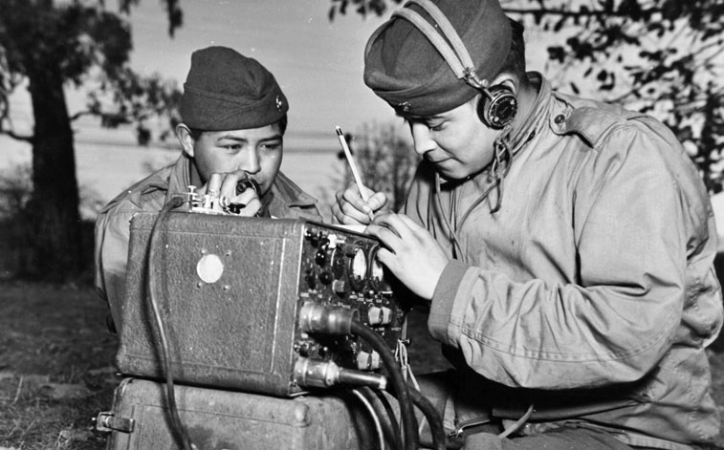
Role of Minority Groups
Women
African Americans
Japanese Americans
Navajo Indians
(Native Americans)

Slide 11
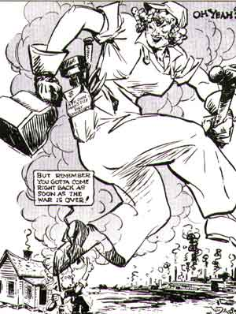
Women entered manufacturing jobs that men left behind when they went overseas to fight
1941-14.6 million women in the workforce
1944-19.4 million women in the workforce

Slide 12
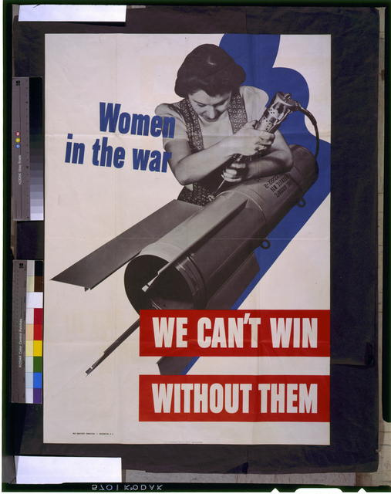
Women
Women produced war time goods:
Guns
ammunition
ships
plane
Women served at home in the WAACS serving in non combat
WASPS piloting planes from air bases within the US

Slide 13
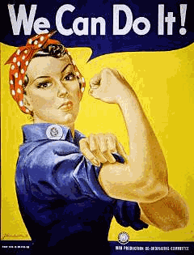
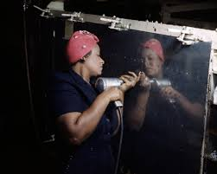
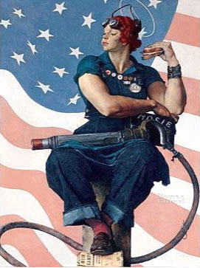
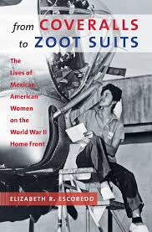
Rosie the riveter
"Do the Job He Left Behind" was a campaign slogan that emphasized women’s patriotism for the war effort.

Slide 14
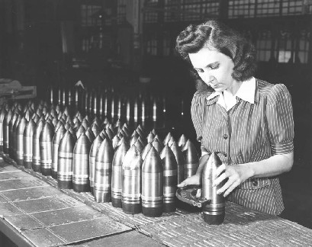
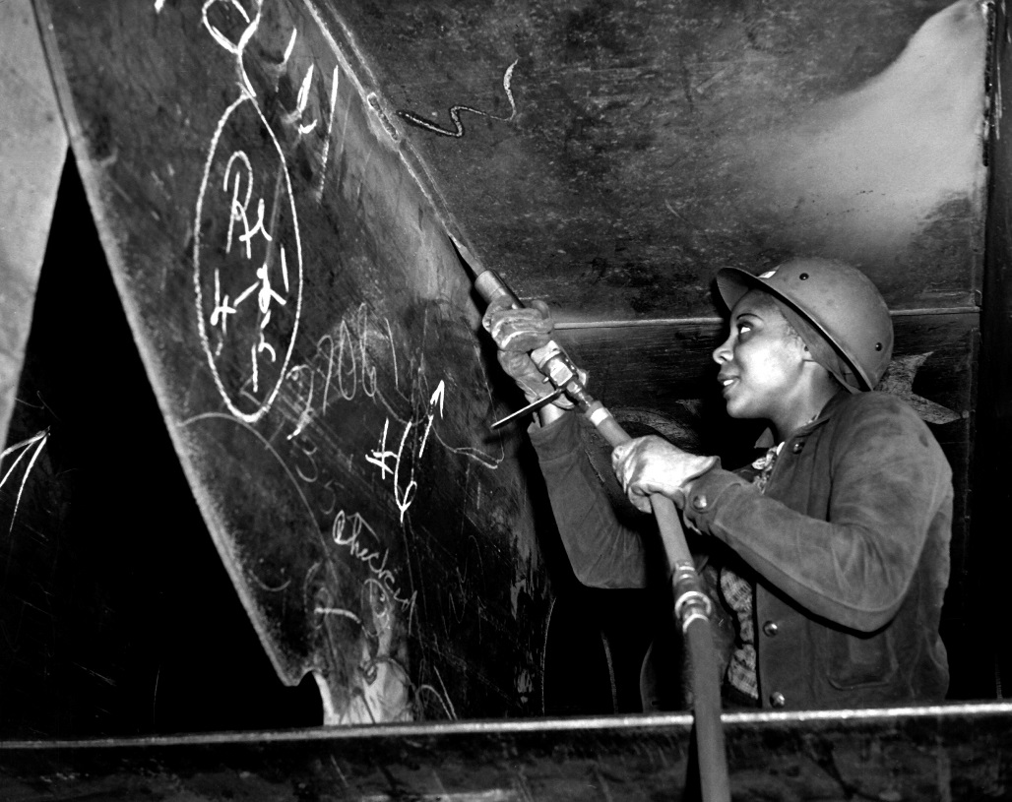
In 1945 the US manufactured 300,000 airplanes, 80,000 landing craft, 100,000 tanks and armored cars, 6 million rifles, carbines and machine guns, and 41 million rounds of ammunition

Slide 15
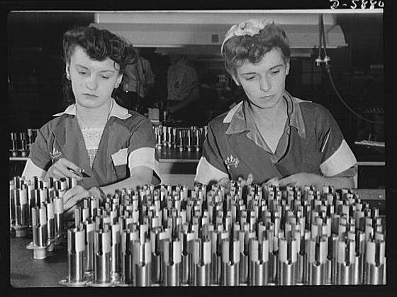
The War Production Board helped turn the industry from peacetime into a manufacturing WAR MACHINE.

Slide 16
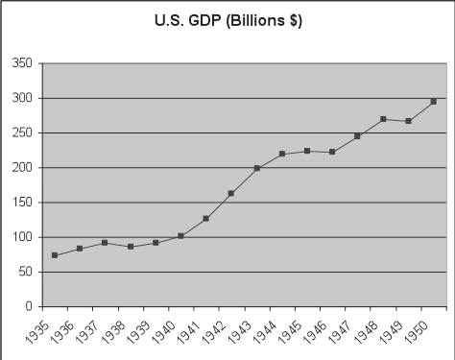
America goes to Work
As manufacturing and production increased, the
US GDP rose the economy dramatically improved.

Slide 17
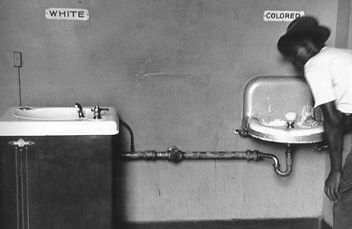
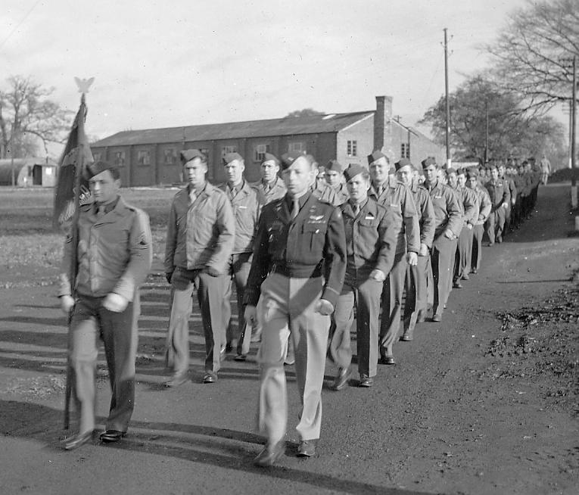
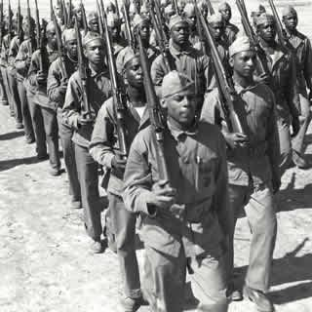
The US is still in segregation during WWII…the military is segregated as well
Plessy v. Ferguson…
“Separate but equal”
Segregated military

Slide 18
African Americans
A. Phillip Randolph , frustrated by factories resistance to hiring blacks, decided to Roosevelt that he was organizing “from ten to fifty thousand [African Americans] to march on Washington in the interest of securing jobs… in national defense and… integration into the military and naval forces”
Roosevelt issued Executive Order 8802 on June 25, 1941
  “there shall be no discrimination in the employment of workers in defense industries or government because of race, creed, color, or national origin”
Fair Employment Practices Commission → first civil rights agency the federal government had established since the Reconstruction era

Slide 19
Bell Ringer

Slide 20
Set: Quiz
Review Standards:
1.Name three ways the U.S. government mobilized industries for war.
  War Production Board (WPB) --Organized nation’s industrial /agricultural output
  The Office of Price Administration (OPA) --Rationing, limit inflation / shortages
  The National War Labor Board (NWLB)--Imposed ceilings on wage increases
2. List four ways the government took control of the economy and funded the war.
    Rationing
    Victory Gardens
    Scrapping
    Victory/war bonds
    Limiting strikes
3. How did the roles of minorities begin to shift in WWII?
-Women serve in non-traditional jobs---working in war related industry
-A. Philip Randolph threatens to march on Washington if discrimination
in wartime industry doesn’t end------FDR issues Executive Order 8802
- And more to come!

Slide 21
Jigsaw Grouping Activity
Minority Studies WWII

Slide 22
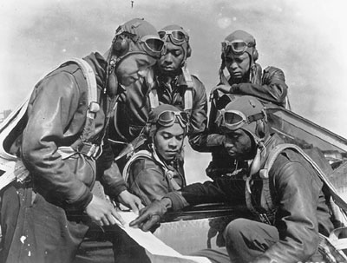
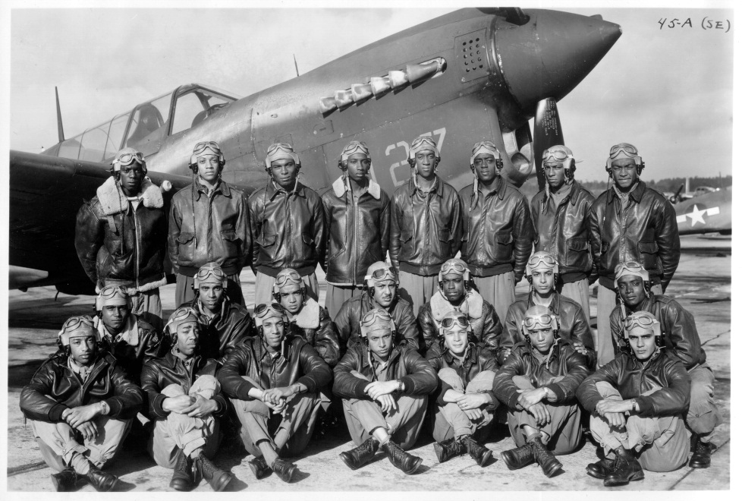
Tuskegee Airmen
What were some of the accomplishments of the Tuskegee Airmen?
150 Distinguished Flying Crosses
14 Bronze Stars
744 Air Medals
8 Purple Hearts
The Tuskegee Airmen formed the first African American fighting unit in the US military
They were permitted to enter the military and fight once the US faced mounting casualties
445 deployed, 150 died in combat
Notes:
The test will say they disproved traditional; stereotypes

Slide 23
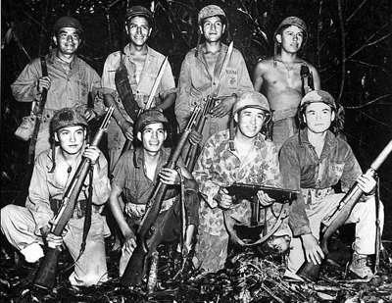
Navajo Code Talkers
The Navajo Code Talkers were instrumental in winning the war in the Pacific. Their transmissions marked the turning point in the war.
Members of the Navajo tribe, a Native American tribe mainly from the New Mexico area, were recruited to speak in code to prevent the Japanese from intercepting American messages

Slide 24
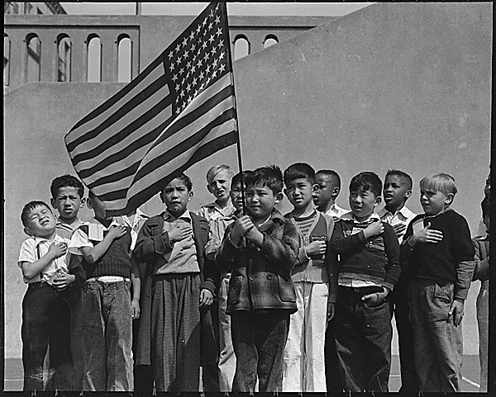
Japanese
After the Japanese attack on Pearl Harbor, many Americans became afraid that Japanese-Americans were a threat to the national security of the United States.
Why?

Slide 25
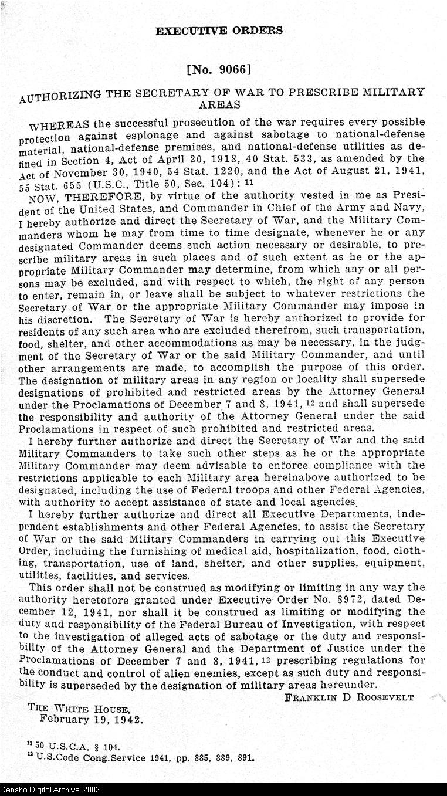
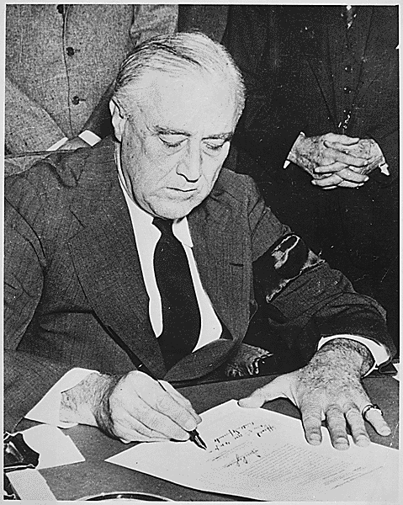
Japanese-American Internment
Acting on these fears, Franklin D. Roosevelt signed Executive Order 9066, which declared that all Japanese Americans must report to internment camps.

Slide 26
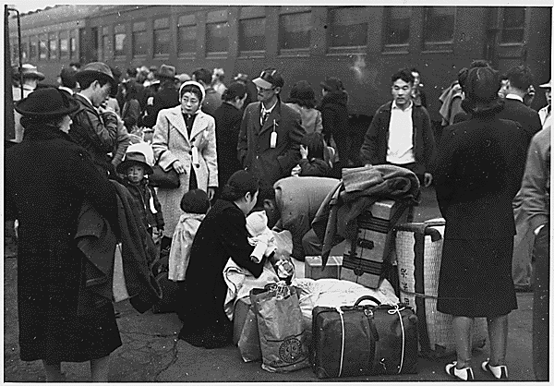
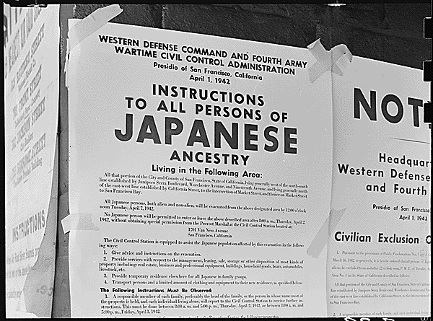
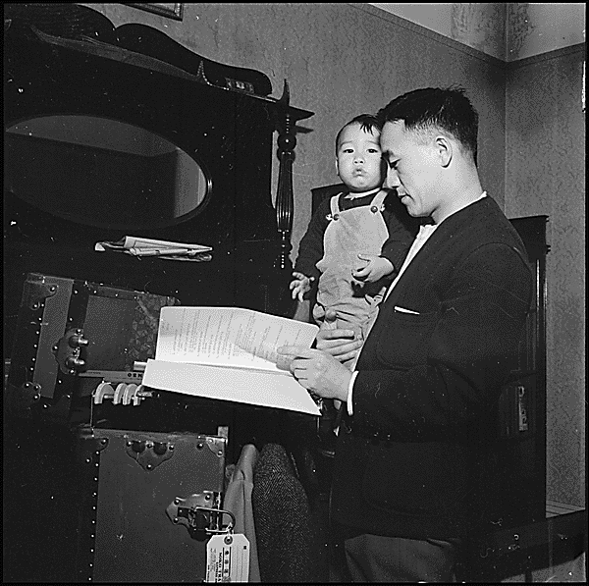
Japanese-American Internment
Japanese-Americans had to pack up their lives and leave their homes behind.
Some left behind businesses and jobs that they would have difficulty regaining upon their return.
In the case of Korematsu v. the U.S. the court said Internment was Constitutional
The decision of the Supreme Court stated that “in clear and present danger” your rights may be denied.
Notes:
Japanese Americans lost possessions, property and money.

Slide 27
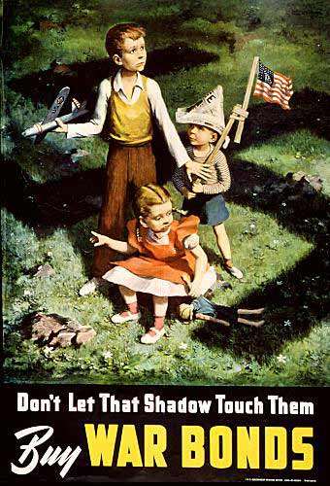
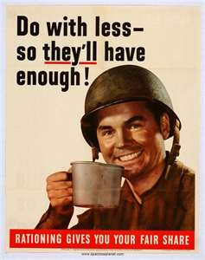
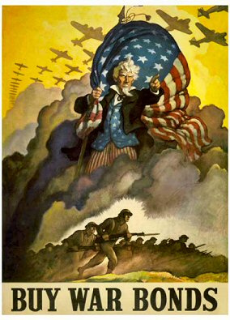
The work on the homefront became the Patriotic duty of all Americans!
Theyre sacrifice earned them the the title are the greatest generation!

