Slide 1
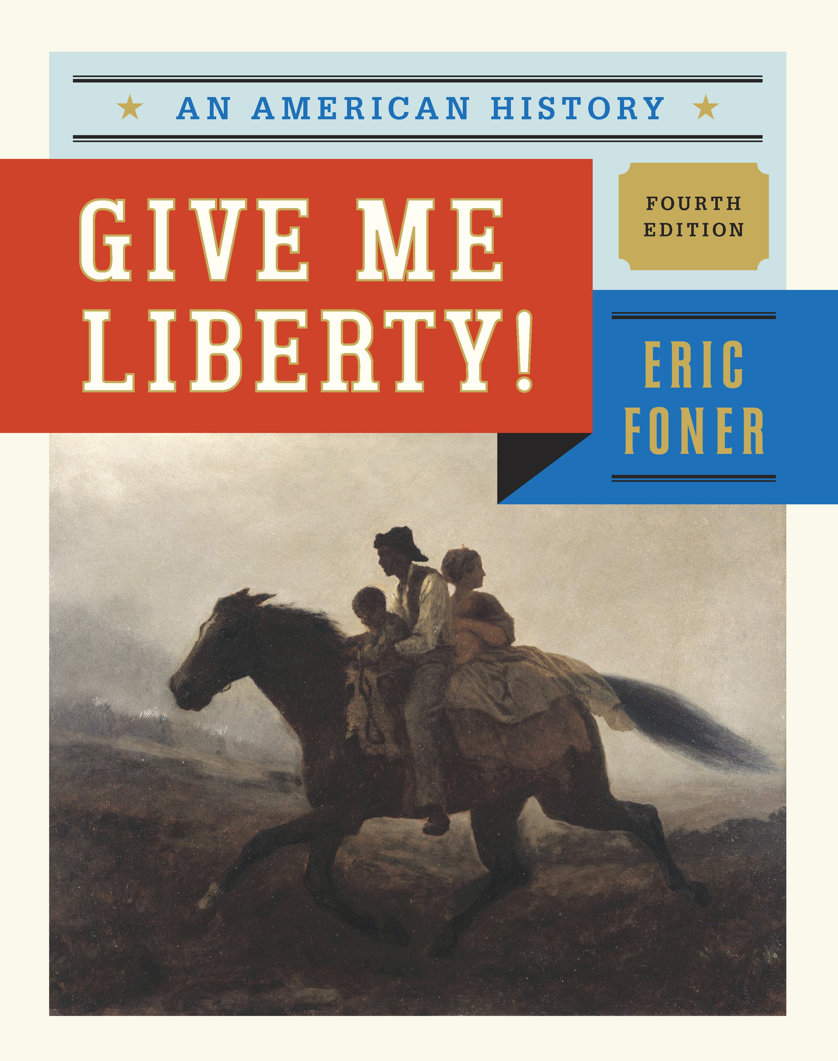
Norton Lecture Slides Give Me Liberty! AN AMERICAN HISTORY FOURTH EDITION by Eric Foner

Slide 2
Chapter 2
Notes:
Chapter 2 Beginnings of English America, 1607–1660

Slide 3
England and the New World
Unifying the English Nation
Internal division occurred when Henry VIII launched the Protestant Reformation
Power of the Anglican Church assured by Elizabeth I
1588 defeat of the Spanish Armada
Notes:
In the sixteenth century, England was a second-rate power in Europe weakened by internal divisions, especially those between Catholics and Protestants once King Henry VIII launched the Protestant Reformation in England by severing the nation from the Catholic Church and establishing the Church of England, or Anglican Church, with himself at its head. Queen Elizabeth I, who ruled from 1558 to 1603, finally secured the power of the Anglican Church and successfully defended England from its Catholic enemies on the continent, notably the Spanish, whose attempt in 1588 to invade by a massive armada was repulsed.
Well into the 1600s, the English also attempted to subdue Ireland and its Catholic population, in part through military conquest and colonization. The English expelled Irish Catholics from land to make room for Protestant settlements, called “plantations.” The cultural practices and ideas that defined England’s colonization of Ireland shaped its conquest of North America.

Slide 4
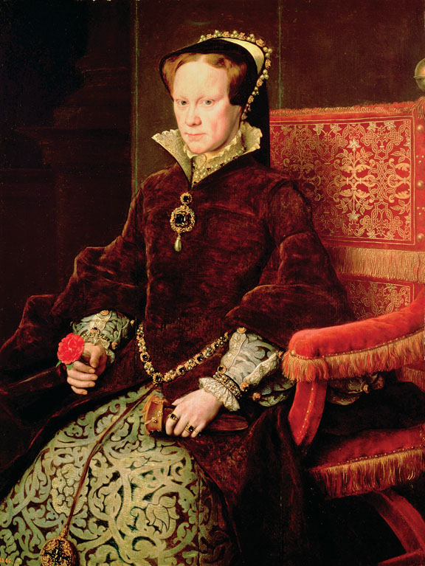
Portrait of Mary Tudor
Mary Tudor, the queen who tried to restore Catholicism in England.
Give Me Liberty!: An American History, 4th Edition
Copyright © 2013 W.W. Norton & Company

Slide 5
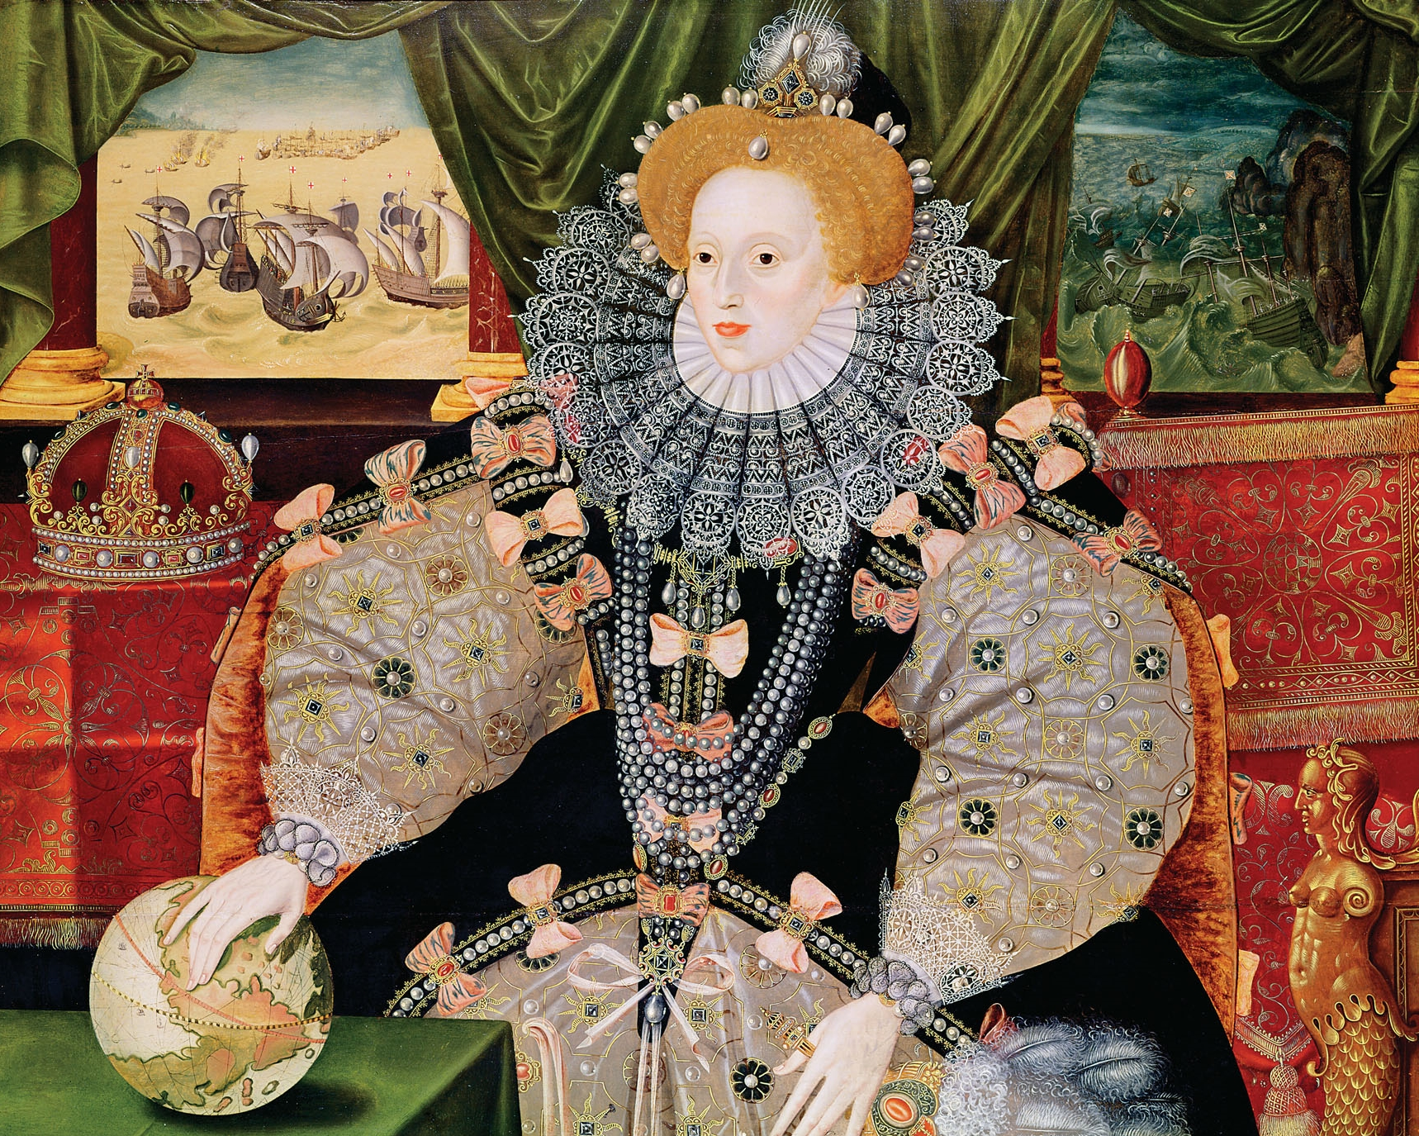
Armada Portrait of Queen Elizabeth I
Give Me Liberty!: An American History, 4th Edition
Copyright © 2013 W.W. Norton & Company

Slide 6
England and the New World: North America
England and North America
Previously only attempted to raid the Spanish
First two colonies failed
Roanoke
Claimed to be saving the Native peoples from the Spanish
Notes:
Only under Queen Elizabeth’s reign did the English look to North America, although at first they were more interested in raiding Spanish cities and treasure fleets than colonization. Their first two colonies in Newfoundland and what became North Carolina were small efforts that quickly failed.
Like the Spanish, however, national glory, profit, and religious mission defined English interest in the New World. The Reformation and Protestant England’s increasing rivalry with and enmity toward the Catholic Spanish empire helped the English see their presence in North America as a way to liberate the New World and its Indians from what many in England believed was a uniquely evil and tyrannical Spanish Catholic empire. The English saw their empire as a very different empire of freedom.

Slide 7
Social Problems
The Social Crisis
Population growth and enclosure of common lands led to a surplus in population
Peasants evicted from land
Masterless Men
Unemployed due to social problems
Could be whipped, branded, hanged, or forced to work
Solution= send them to the New World
Notes:
Other advocates of colonization argued that North America would absorb England’s “surplus” population in a period of economic crisis and population growth. Colonization would drain away the urban poor and peasants who had been evicted from their own lands and the commons by the “enclosures” of large landlords, and who seemed to English elites to threaten social order and stability. Under Henry VIII and Queen Elizabeth I, the unemployed could be whipped, branded, hanged, or even forced to labor. Voluntary or involuntary emigration to the New World seemed an alternative that would simultaneously benefit the poor and the English nation.
In turn, images of America such as that which appeared in Thomas More’s Utopia promoted the New World as a place of wealth and opportunity where men could escape the hierarchies and inequalities of Europe, gain economic independence by owning land, and rule themselves. These images appealed to ordinary Englishmen and encouraged them to risk migration to America.

Slide 8
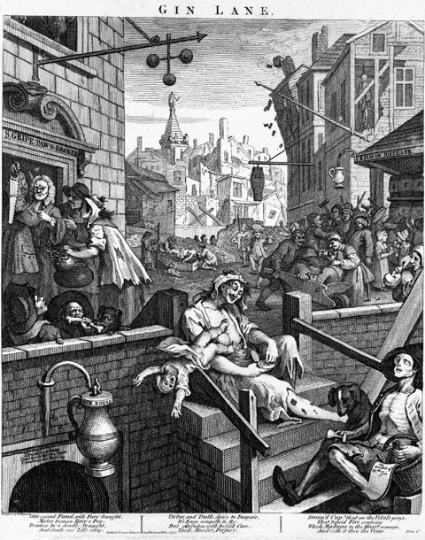
Give Me Liberty!: An American History, 4th Edition
Copyright © 2013 W.W. Norton & Company
William Hogarth’s well-known engraving Gin Lane

Slide 9
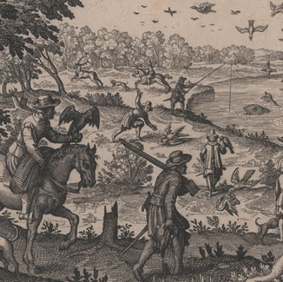
An engraving by Theodor de Bry depicts colonists hunting and fishing in Virginia.
Give Me Liberty!: An American History, 4th Edition
Copyright © 2013 W.W. Norton & Company

Slide 10
Emigration
English Emigrants
Diseases
Conflict with Native Americans
First people to the Chesapeake colonies were mostly men
Indentured Servants
Hoped to achieve land and liberty
Most died before 5 to 7 years was up or did not earn enough to buy land
Notes:
Emigration was risky. Diseases, internal religious, political, and economic tensions, and imperial wars and conflicts with Indians all threatened harm or death. Dependent on England for protection and economic aid, most settlements would have collapsed without such support and further emigration. Because economic conditions in England were so bad, more migrants in the seventeenth century—more than half a million—left England than in France or Spain. Most of the English who came to North America were young, single men from the lower ranks of English society, and they settled in the tobacco-producing colonies of Virginia and Maryland, where labor demand was high, while the rest settled in New England and the middle colonies of New York, New Jersey, and Pennsylvania.
Settlers who could afford their own passage arrived as free persons, and soon acquired land. In the 1600s, however, most Englishmen arrived as indentured servants, who voluntarily surrendered their freedom for a period of time (often five to seven years) in exchange for passage to America. Servants were as unfree as slaves in some ways: they could be bought and sold, could not marry without their owner’s permission, were subject to physical punishments, and could not refuse to work. Unlike slaves, however, servants, at least those who survived their term of labor (not many, for most of the seventeenth century), eventually became free and received “freedom dues,” sometimes including land.
Land for the English was the basis of liberty, allowing men control over their own labor and, in most colonies, the vote. The English crown also awarded land grants, sometimes quite extensive, to relatives and allies. Because land was so plentiful and so many English migrants, both free and servant, came to America to gain land and the independence that came with it, property owners soon turned to African slaves as a labor force. Liberty and slavery moved together in early English America.

Slide 11
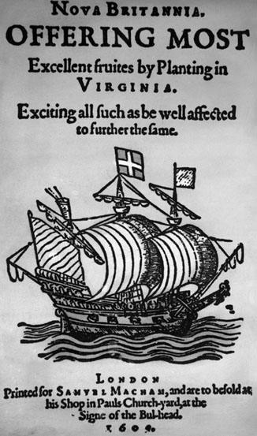
A pamphlet published in 1609 promoting emigration to Virginia
Give Me Liberty!: An American History, 4th Edition
Copyright © 2013 W.W. Norton & Company

Slide 12
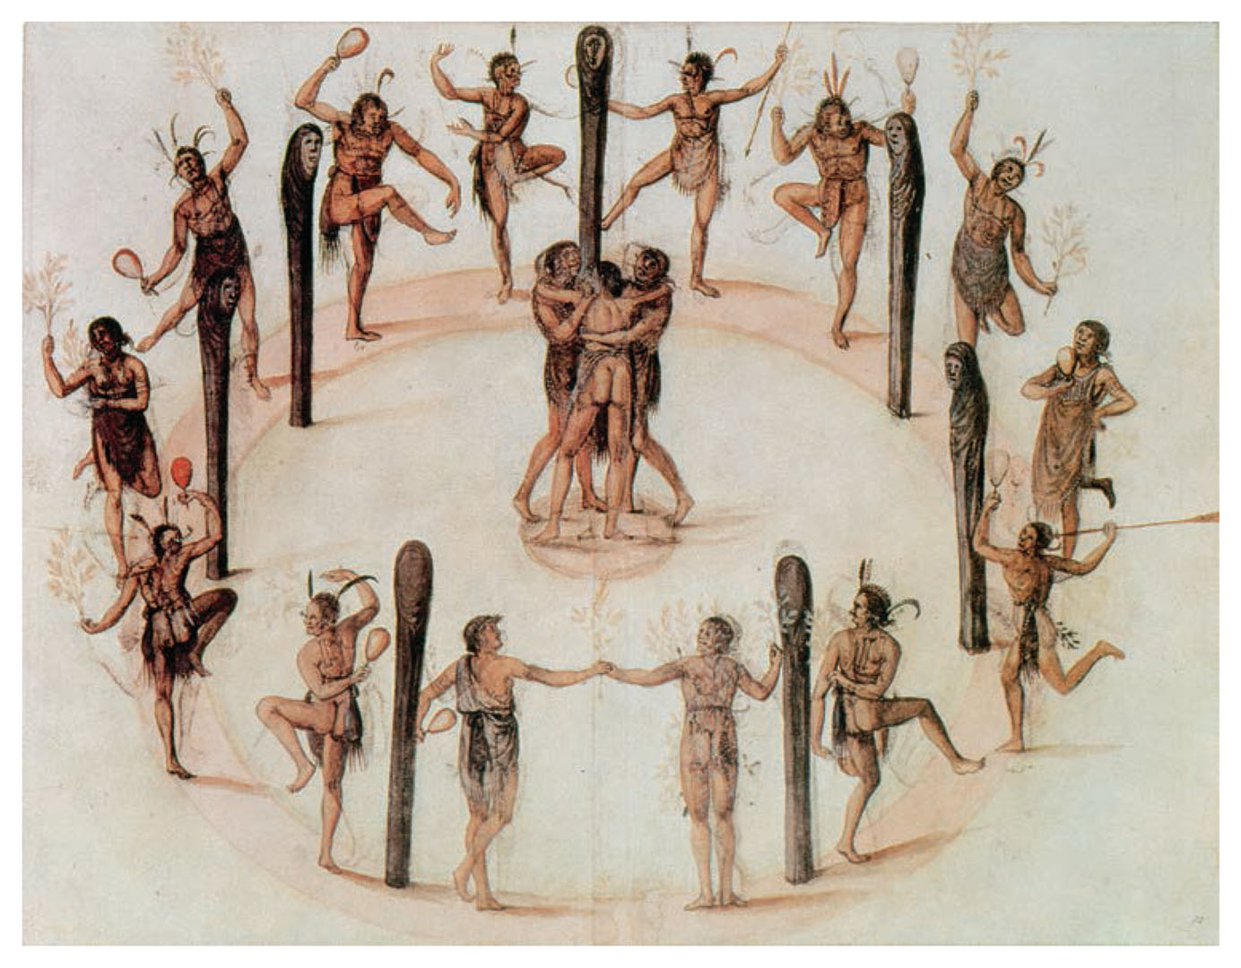
Give Me Liberty!: An American History, 4th Edition
Copyright © 2013 W.W. Norton & Company
Drawing by John White.

Slide 13
Settling the Chesapeake
The Jamestown Colony
First permanent English settlement
Founded by the Virginia Company 1607
High death rate
Rather look for gold and starve instead of farming
Diseases
John Smith imposed order
Began to grow food and created an elected representative assembly
1619:
First meeting of the House of Burgesses & arrival of 20 slaves
Notes:
The first permanent English settlement in the New World was the Jamestown colony, founded in 1607 by the private Virginia Company in 1607. At first, the colony, intended as a means to discover gold or other precious minerals, was plagued by internal divisions, a high death rate, and few supplies from England. While colonists’ hopes for quick riches were soon dashed, few had any experience with agriculture, leading to starvation which, when compounded by disease and illness, led to a high death rate. Few initial settlers survived the first year, and only military discipline imposed by a former soldier, John Smith, saved the colony.
To become viable and attract settlers, the Virginia Company stopped looking for gold, started to grow its own food and a marketable commodity, and created an elected representative assembly. The company awarded land to those who paid their own or others’ passage, and issued a “charter of grants and liberties,” which included a House of Burgesses, the first elected assembly in colonial America (though only landowners could vote). The arrival in 1619 of the first twenty blacks in Virginia marked, along with the meeting of the House of Burgesses that year, the conjoined development of freedom and slavery in English America.

Slide 14
Headright System
Gave 50 acres of land to any colonist who paid for his own OR another's passage
Encouraged people to bring over a sizable number of servants in order to gain a state
further led to the large scale production of tobacco

Slide 15
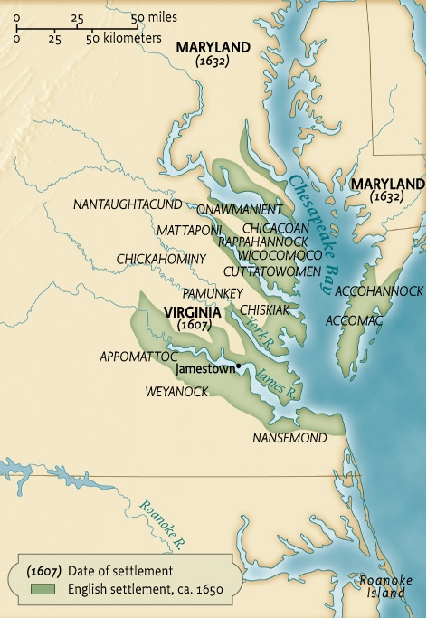
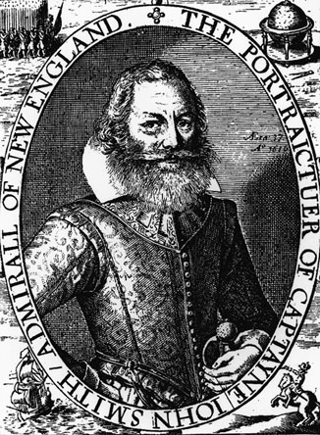
Give Me Liberty!: An American History, 4th Edition
Copyright © 2013 W.W. Norton & Company
Map 2.1 English settlement in the Chesapeake, ca. 1650.

Slide 16
Chesapeake Native Americans
15,000 to 25,000 lived in the Chesapeake before the arrival of the English
Wahunsonacock was the leader of the Powhatan Indian and thirty subordinate tribes
English incorrectly called him Powhatan
Relationship with the English was mostly peaceful for the first 2 years
Notes:
Native Americans ruled by Powhatan already lived in the area of Virginia colonized by the Jamestown settlers. At first, the English, dependent on the Indians for food, tried to maintain friendly relations. When John Smith was captured by the Indians, Powhatan’s daughter Pocahontas, probably playing out her role in an elaborate ceremony, intervened to save Smith from execution. Pocahontas gradually became an intermediary between the Jamestown colony and Powhatan’s people.
Sporadic fighting lasted between the Indians and the Jamestown colonists until 1614. But the peace declared that year was broken in 1622 by Powhatan’s successor, whose surprise attack nearly wiped out one-quarter of Virginia’s small settler population. Jamestown’s survivors retaliated by massacring scores of Indians and destroying their villages. The English now held the balance of power in the colony, and Virginia, which soon became the first royal colony of England, began to stabilize and slowly increase its population, in part by turning to the cultivation of tobacco.

Slide 17
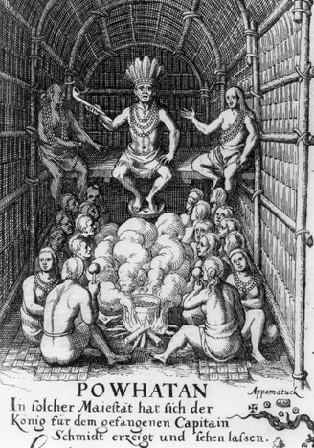
Powhatan, the most prominent Indian leader in the original area of English settlement in Virginia.
Give Me Liberty!: An American History, 4th Edition
Copyright © 2013 W.W. Norton & Company

Slide 18
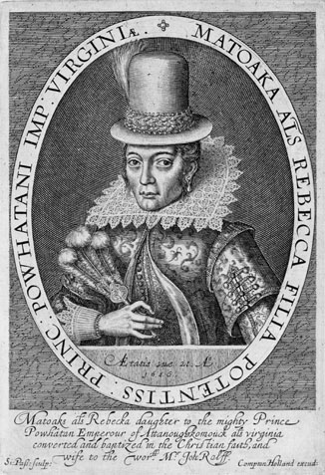
Pocahontas
Give Me Liberty!: An American History, 4th Edition
Copyright © 2013 W.W. Norton & Company

Slide 19
English & Native American Relationship
Englishmen wanted the Indian’s land
Tobacco depleted soil nutrients quickly
Bought land from Indians
Sometimes through treaties forced on Native Americans after engaging in warfare
Notes:
Unlike the Spanish, English colonists did not want to rule over or assimilate the Indians they found; they wanted the Indians’ land. Although English colonial authorities insisted that the Indians had no real claim to the land because they did not farm or improve it, most authorities in practice recognized Indians’ title to land based on their occupancy. English colonists acquired Indian land by purchase, often through treaties forced on the natives after they had defeated them in the recurrent warfare that wracked the English colonies, a process that thoroughly displaced the Indians from their original territories.
Though many eastern Indians initially welcomed English settlers, particularly for the goods they introduced to native culture, such as cloth, metal tools, and guns, many Indians gradually came to resent the changes English colonization wrought in Indian life. Men turned more to hunting beaver and fur trading, older skills fell into disuse with the appearance of English technologies, and alcohol became common and disruptive. As the colonists developed a military advantage over the Indians, profits from the fur trade flowed mostly to colonial and European merchants. English colonists also introduced diseases that led to devastating epidemics. English settlement transformed the land and its uses, threatening Indians’ way of life through fencing, new crops, livestock like pigs and cattle, which trampled Indian crops, and the depletion of forests to supply wood for the English domestic market.

Slide 20
John Smith's return to England resulted in a return to conflict with the Indians
1622: Opechancanough, Powhatan's brother & successor, led a surprise attack on the colonists
wiped out 1/4 of the colonists
Colonists led a counterattack
1644 attack by Opechancanough resulted in defeat and removal to reservations in the west

Slide 21
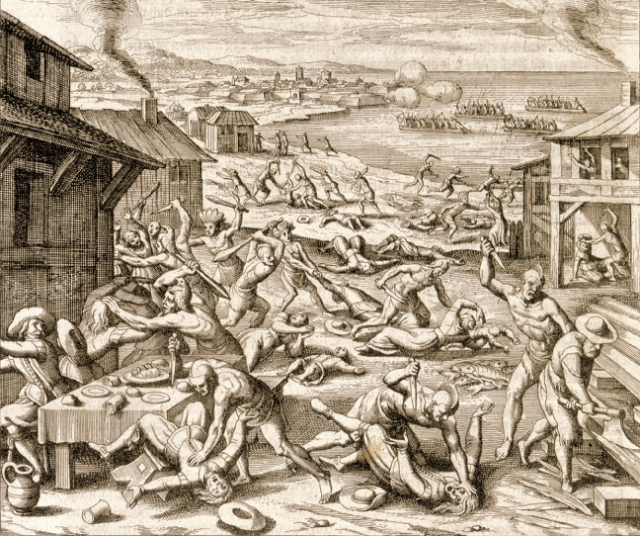
Theodor de Bry’s engraving of the 1622 Indian uprising in Virginia.
Give Me Liberty!: An American History, 4th Edition
Copyright © 2013 W.W. Norton & Company

Slide 22
A Tobacco Colony
1624: 200,000 pounds grown annually
1664: 15 million pounds
1680s: 30 million
Tobacco cultivation resulted in a dispersed society with few towns and little social unity
Notes:
With more Europeans smoking tobacco, the crop became a lucrative basis for the Virginia colony’s survival and growth. Soon a plantation elite with large estates emerged that ruled Virginia’s society and politics, and they soon turned from unreliable and temporary white servant labor to black slave labor. Virginia’s white society came to resemble that of England, with a landed gentry at top, small farmers in the middle, and an army of poor laborers—indentured servants and former servants without land—at the bottom.
Given the demand for male servant labor in the tobacco fields, men at first vastly outnumbered women in the colony, and various factors contributed to late marriage and a low rate of family formation. Although women in Virginia, as in England, had few legal rights, conditions in the colonies gave women roles they could not assume in the mother country. Widows and unmarried women embraced their right to conduct business, make contracts, and even sometimes administer estates. But most white women arrived in Virginia as indentured servants, often subject to hard labor and even sexual abuse from their masters.

Slide 23
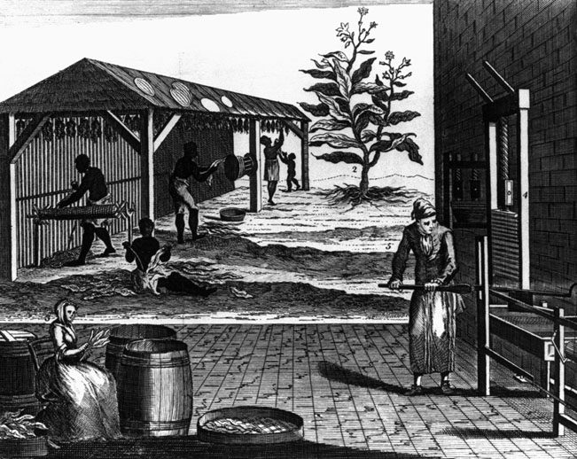
Processing tobacco was as labor-intensive as caring for the plant in the fields.
Give Me Liberty!: An American History, 4th Edition
Copyright © 2013 W.W. Norton & Company

Slide 24
Tobacco Brides
Virginia society lack a stable family life due to a lack of women
Arranged marriages took place in 1620 &1621 for several dozen women to encourage them to settle in the colony
Lack of women & high death rate kept the population from growing

Slide 25
Women
most came as indentured servants
Low life expectancy of men led to:
inability to oversee marriage & careers of their children
some women were willed all of their husband's property
Single women enjoyed the rights of femme sole
make contracts & conduct business

Slide 26
Maryland
Est. 1632 as a proprietary colony of Cecilius Calvert
Catholic
envisioned Maryland as a haven
both Protestants & Catholics settled Maryland
Appointed officials were Catholic (often relatives of Calvert) and received the best land
Protestant settlers formed the majority of settlers
Notes:
While Maryland, like Virginia, was a tobacco colony, it was established later, in 1632, by King Charles I as the proprietary colony of Cecilius Calvert. Calvert ruled Maryland like a feudal domain, controlling its trade and the decisions of its elected assembly, despite the charter’s guarantee giving ordinary Maryland colonists all the rights and privileges of Englishmen.
Calvert, a Catholic, also saw Maryland as a refuge for persecuted fellow Catholics in England, and at first he hoped Catholics and Protestants could live there in harmony. But Protestants, mostly indentured or former servants, soon outnumbered Catholics, and their frustration mounted as they faced diminishing opportunities for land ownership in the latter half of the seventeenth century.

Slide 27
70% of men died before reaching 50
half of all children did not reach adulthood
freedom dues included 50 acres of land

Slide 28
New England: Puritans & Pilgrims
Puritans sought to "purify" or fix problems with the Church of England
too much "popery"
Pilgrims were separatists which wanted to break away
Notes:
Whereas Virginia and Maryland quickly became societies dominated by a small aristocracy ruling over many bound laborers, New England colonial society evolved differently. Early New England was decisively shaped by the Puritans, a diverse group of English Protestants united by their belief that the Anglican Church retained too many of the practices and doctrines of the old Catholic Church. They mainly were “Congregationalists,” who rejected Catholic structures of religious authority retained in the Anglican Church, such as archbishops, bishops, and priests, and instead embraced independent local congregations that chose their own clergy, determined their mode of worship, and often listened to sermons and personally studied the bible. Like many English and Anglicans, however, Puritans shared a hatred of Catholicism and celebrated England’s greatness and devotion to liberty. As followers of John Calvin’s theology, the Puritans believed God had predestined different groups of people, the “elect,” to be saved from damnation; no amount of good deeds or good works could save those not among the elect.
When a minority of Puritans in England separated from the Church of England, some Puritans decided to emigrate to America in order to fully practice their Protestant faith away from the influence and control of the Anglican Church and the English government that enforced its rules. One leader of the Puritan emigrants who settled in the Massachusetts Bay, John Winthrop, hoped to found “a city set upon a hill,” where Puritans would reject “natural” liberty, or action without restraints he believed typically practiced by the Irish, Indians, and bad Christians, for a “moral” liberty to do “that only which is good,” in which Puritans became free by accepting severe restraints on speech, religion, and personal behavior.

Slide 29
Pilgrims
1620: arrived in Cape Cod
looking for a religious safehaven
blown off course
arrive 6 weeks before winter with no food or farm animals
half died the first winter
half survived only because of the Native Americans

Slide 30
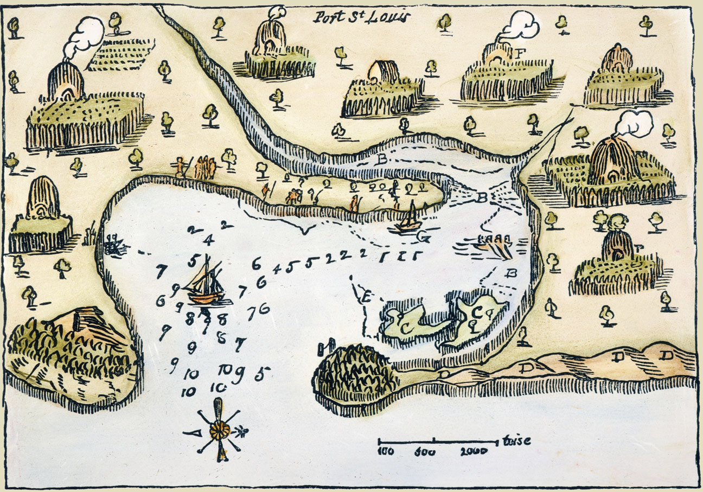
Sketch of plymouth harbor
Samuel de Champlain’s 1605 sketch of Plymouth Harbor.
Give Me Liberty!: An American History, 4th Edition
Copyright © 2013 W.W. Norton & Company

Slide 31
Mayflower Compact
Written agreement which stated that they would obey "just and equal laws" enacted by representatives of their own choosing
first written frame of government
sets a precedent
voting not restricted to church members

Slide 32
Massachusetts Bay Colony
1629: founded by a group of merchants
1629-1640 movement of Puritans to New England known as the Great Migration
most came in families
healthier climate + even sex ratio = rapid population growth
doubled every 27 years
white population drastically outnumbered that of the Chesapeake and West Indies

Slide 33
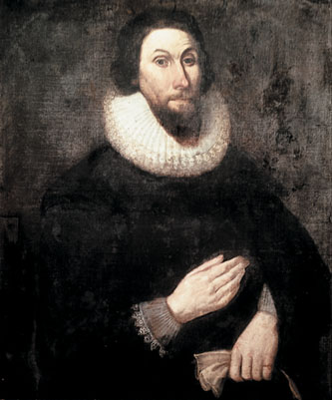
John Winthrop
Give Me Liberty!: An American History, 4th Edition
Copyright © 2013 W.W. Norton & Company

Slide 34
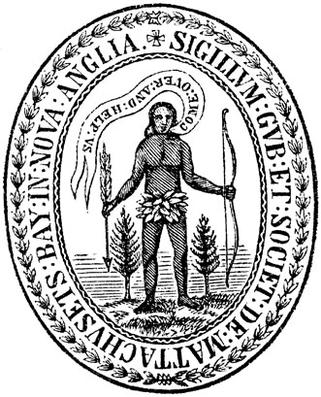
Seal of the Massachusetts Bay Colony
Give Me Liberty!: An American History, 4th Edition
Copyright © 2013 W.W. Norton & Company

Slide 35
Puritan society
reproduced social structure of England
men were head of household
Women
full church membership
divorce legal (although rare)
obey husband fully
true freedom came from performing social role and submitting to husband's authority
Notes:
In New England, families and the patriarchal authority of the Puritan husband and father defined colonial society. These adult men controlled the labor of women and children in a farming society without large numbers of slaves or indentured servants. Though women were held to be spiritual equals to men, and could become full members of the church, women were legally subservient to male authority in the home. The average New England woman married young, gave birth seven times, and spent most of her life bearing and raising children.
Puritans feared excessive individualism and social disorder, and organized themselves in small and compact, self-governing towns, centered on a Congregational Church and eventually a school (mostly for reading the Bible), surrounded by small house and farming lots for individual families. The colony’s government reflected this religious and social vision. The Massachusetts Bay’ Company’s shareholders transformed their commercial charter into a government document, first choosing the colony’s rulers, but in 1634 deputies elected by freemen (landowning church members) constituted a single legislature, the General Court. Ten years later, company officers and elected deputies were divided into two legislative houses, and unlike in Virginia or Maryland, freemen were able to elect their governor. The principle of consent was central to all of Puritan life, including church and state, but Puritan democracy, especially voting in colony-wide elections, was limited to members of the church, an ever-smaller number as the colony grew over time.

Slide 36
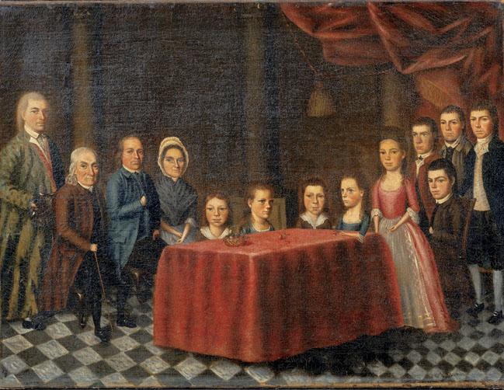
The painting the savage family
The Savage Family, a 1779 painting by the New England artist Edward Savage.
Give Me Liberty!: An American History, 4th Edition
Copyright © 2013 W.W. Norton & Company

Slide 37
Massachusett's Government & Society
Self-governing towns
each had a Congregational Church & school
Harvard est. 1636
freemen elected the governor

Slide 38
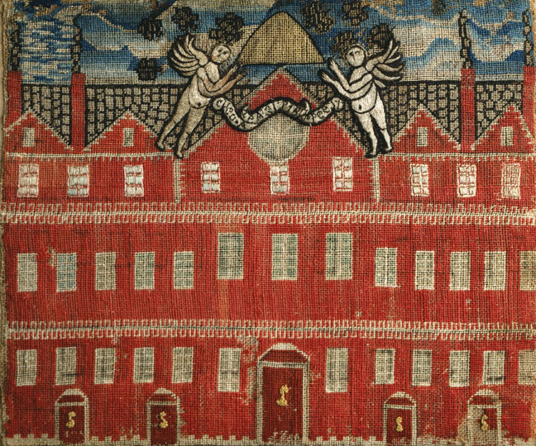
Banner of Harvard building
An embroidered banner depicting the main building at Harvard.
Give Me Liberty!: An American History, 4th Edition
Copyright © 2013 W.W. Norton & Company

Slide 39
New Englanders Divided: Religion
Roger Williams
Puritan minister who preached that any citizen ought to be free to practice whatever religion they chose
Wanted to separate church & state
Banished from Massachusetts in 1636
He and his followers moved south to found Rhode Island
Notes:
Although New England’s Puritans respected individual judgment, they disdained individualism and considered too much emphasis on the self as dangerous to social harmony and stability. In the region’s compact towns, residents monitored each other and punished or ostracized those who violated communal norms. Dissenters were not so much free to dissent as they were free to leave the Puritan community if they transgressed Puritan social and religious norms.
Dissenter Roger Williams suggested that Massachusetts Bay should separate church and state, argued that its congregations should withdraw from the Anglican Church, and also rejected the conviction that Puritans were an elect people on a divine mission to spread the true Protestant faith. When banished from the colony, Williams and his followers founded Rhode Island, which became a beacon of religious freedom, with no established church or religious qualifications for voting. Other religious dissenters went on to found the colonies of Hartford and New Haven, which in 1662 united as the colony of Connecticut.
The Puritan establishment found one dissenter, Anne Hutchinson, particularly threatening, for her gender and influence with other colonists. She argued that inner grace, not just church attendance and moral behavior, determined who could be a member of the saved Puritan elect. Denounced by church and state authorities for “Antinomianism” (putting one’s own judgment or faith above human law and Church teachings), Hutchinson was put on trial and banished from the colony.

Slide 40
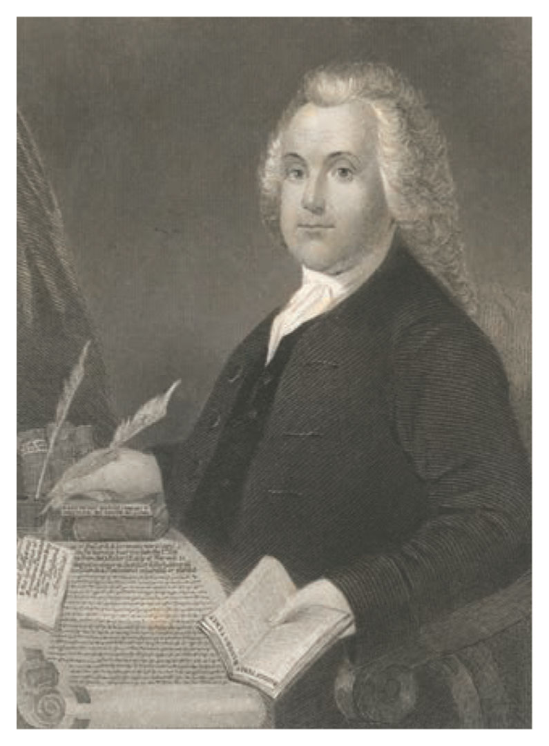
Portrait of roger Williams
Give Me Liberty!: An American History, 4th Edition
Copyright © 2013 W.W. Norton & Company

Slide 41
Rhode Island & Connecticut
Rhode Island
becomes a beacon of religious freedom & democratic government
no est. church
no religious qualifications for voting
no requirement to attend church
Connecticut
New Haven & Hartford were also spinoffs of the Massachusetts Bay Colony
joined to form Connecticut in 1662

Slide 42
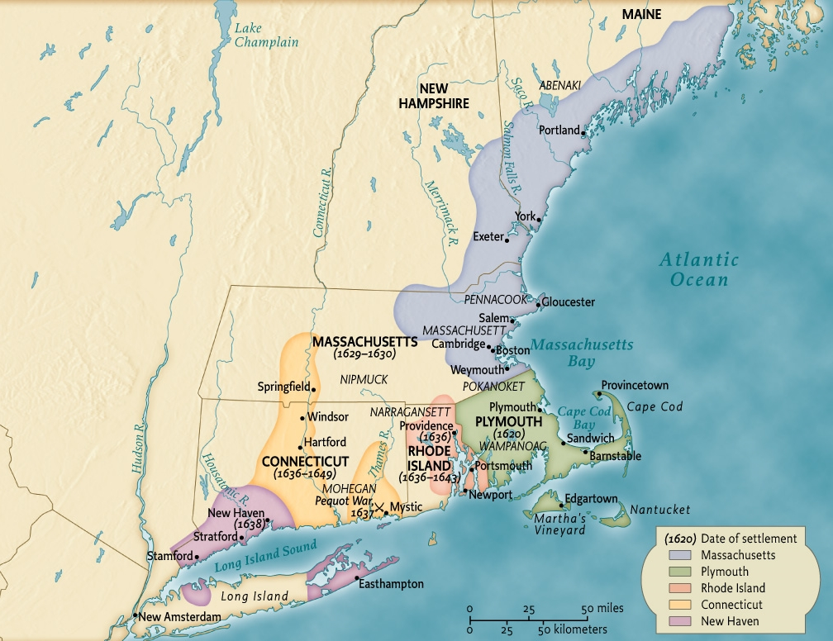
Map of new england settlements
Give Me Liberty!: An American History, 4th Edition
Copyright © 2013 W.W. Norton & Company
Map 2.2 English Settlement in New England, ca. 1640.

Slide 43
The Trials of Anne Hutchinson
Charged that nearly all ministers were guilty of faulty preaching
Placed on trial for sedition in 1637
charged with Antinomianism
She and her followers were banished
died in a Native American attack in New York

Slide 44
Religious Persecution
Quakers were hanged in Massachusetts
Most thought that religious tolerance violated "moral liberty"

Slide 45
Pequot War
A fur trader was killed by the Pequots
Colonists mount a counter attack in 1637 & exterminate the tribe
Notes:
The Puritans, who recognized Indians’ claim to the land and sought to acquire it through purchase, also tended to see the Indians as savages and heathens, similar to Catholics in their deceptive rituals and worship of false gods. Afraid that undisciplined Indian life might attract some colonists, Puritan New Englanders hoped to prevent their fellow Englishmen from joining native tribes by passing punitive laws and publishing narratives of captivity promoting Christian life in the colony. Although the Puritans rhetorically advocated the conversion of Indians to Christianity, they initially made few efforts to do so.
As the white population of New England increased, so did tensions with the region’s Indians. In 1637, colonists responded to the murder of a fur trader by a few members of the Pequots, a powerful tribe in southern New England that controlled the fur trade, by destroying a Pequot village at Mystic, Connecticut, massacring more than 500 men, women, and children. The Pequots’ defeat led to further white settlement in western New England and intimidated local Indians into quiescence for nearly four decades.

Slide 46
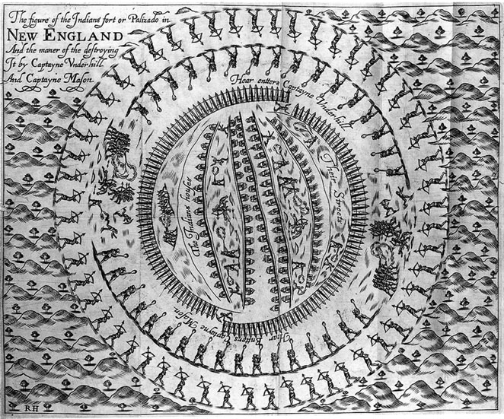
Engraving of destruction of Pequot Village
An engraving from John Underhill’s News from America.
Give Me Liberty!: An American History, 4th Edition
Copyright © 2013 W.W. Norton & Company

Slide 47
New England Economy
most migrants were textile craftsmen & farmers
exported fish & timber
family farms were still central
Wealth was more evenly distributed than in the Chesapeake
powerful merchant class rose in the mid to late 17th century due to their trade with the British empire
Portsmith, New Hampshire est. after conflict with the church over materialism
Notes:
Although Puritan leaders celebrated religion as their primary motive for emigrating to America, profit and prosperity were always central to many Puritans’ decisions to go to New England. Many were well-off in England but lived in economically depressed areas, and sought opportunity in the New World, especially in the form of landownership or a craft. While many New Englanders made a living by exporting fish and timber to Europe, most survived on subsistence family farming and the small surpluses this produced. Compared to the southern colonies, in New England there were few slaves and fewer indentured servants.
Although New Englanders were not as wealthy as colonists in the Chesapeake region, wealth was distributed more equally than in Virginia or Maryland. But economic development was accompanied by social inequality, with a growing number of wage earners and a merchant elite profiting from an expansive trade in goods between the West Indies, Europe, and Africa.
This economic growth and increasing commercialization worried some Puritan leaders, with fewer members of the Massachusetts colony being eligible for church membership. The Half-Way Covenant of 1662 was designed to solve this problem by enabling third-generation Puritans, those least likely to have met the “conversion” standard of church membership, to become church members merely because they were descend ants of original Puritan settlers. By the late seventeenth century, ministers were excoriating colonists for violations such as selfishness, pride, and violation of the Sabbath in lengthy sermons called “jeremiads.”

Slide 48
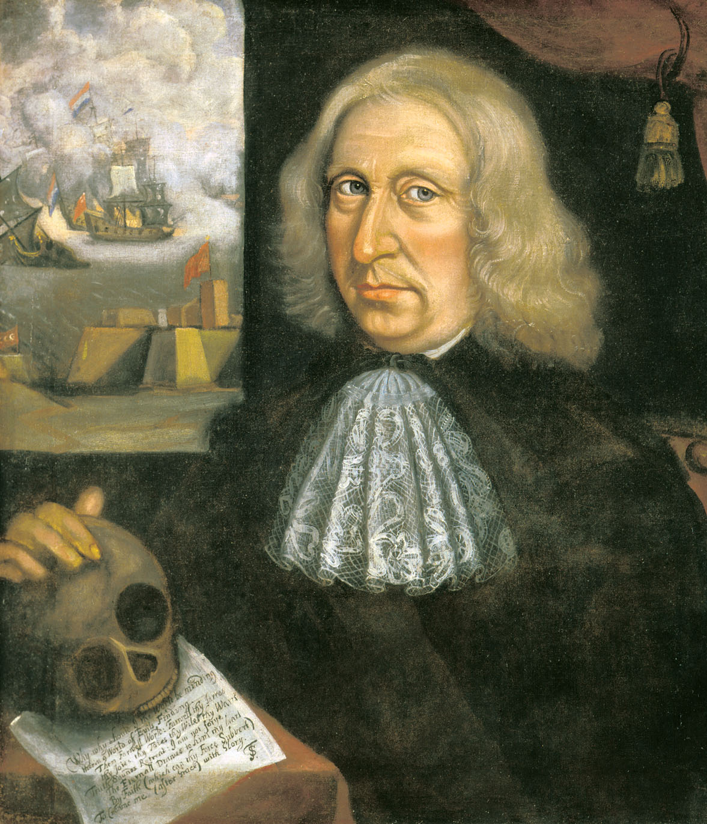
Portrait of Thomas Smith
A self-portrait from around 1680, painted by Thomas Smith.
Give Me Liberty!: An American History, 4th Edition
Copyright © 2013 W.W. Norton & Company

Slide 49
Half-way covenant
Growing merchant class became less religiously devout which made it difficult to become full members of the church
1662: Half-Way Covenant allowed the children of the second generation to be baptized and become church members
this was even though roughly half their parents had not had the "conversion experience" necessary to est. full church membership

Slide 50
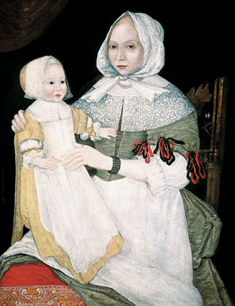
Painting Mrs. Elizabeth Freake and baby Mary
Give Me Liberty!: An American History, 4th Edition
Copyright © 2013 W.W. Norton & Company

Slide 51
The Rights of Englishmen
By 1600, the idea that all Englishmen enjoyed certain rights was well-established
Magna Carta - 1215: King forced to concede liberties to local lords ( all "free" men)
protection against arbitrary imprisonment (habeas corpus) and seizure of land without due process of law
came to include trial by jury and the right to face one's accuser
Notes:
By 1600, the traditional view of English “liberties” as a set of privileges limited to certain social groups was competing with a notion that certain “rights of Englishmen” applied to everyone in the kingdom. This tradition rested on the Magna Carta of 1215, in which the king had given rights to all “free men” in England, including protection against arbitrary imprisonment and the seizure of property without due process of law. Over time, this document came to signify a particularly “English freedom,” where the king was subject to the rule of law and all persons enjoyed security of person and property, and which was embodied in common law rights like habeas corpus and trial by jury. As the serfdom characteristic of feudalism receded, more and more Englishmen were considered “freeborn” and entitled to these rights.

Slide 52
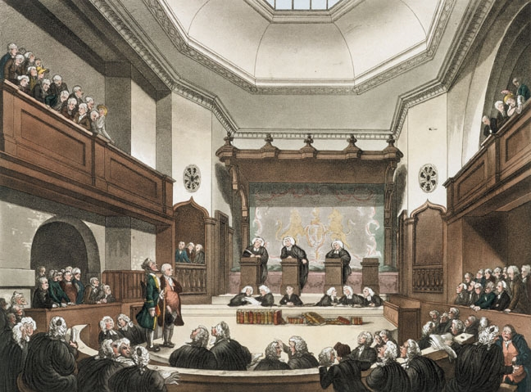
Painting the court of common pleas
Give Me Liberty!: An American History, 4th Edition
Copyright © 2013 W.W. Norton & Company

Slide 53
The English Civil War
Arose out of power struggles between Parliament & Stuart monarchs James I and Charles I
also out of difference of opinion on how far the Anglican Church should distance itself from the Catholic Church
Notes:
Political and religious divisions within seventeenth-century England heightened the meaning and importance of “freedom” there and in the colonies. The struggle for political supremacy between Parliament and Stuart monarchs James I and Charles I culminated in the 1640s in the English Civil War. Disputes over how and to what degree the Church of England should distance itself from Catholicism, and struggles over the respective powers of Parliament and the king, including the king’s power to impose taxes without Parliament’s consent, provoked a military conflict that ended in a victory for pro-parliamentary forces and the abolition of the monarchy and the execution of King Charles I. The victors established a “Commonwealth and Free State” ruled by Oliver Cromwell that lasted almost a decade. In 1660, the monarchy was restored, and Charles II assumed the throne.
Political strife and upheaval in England in these years produced a rigorous debate about liberty that expanded the boundaries and definitions of freedom. The writer John Milton called for freedom of speech and of the press. A movement called the Levellers proposed a written constitution abolishing both the monarchy and House of Lords, and extending the franchise to those without much property. A more radical group, the Diggers, advocated the common ownership of land. Though the Levellers and Diggers were quickly suppressed, some of their ideas were carried to America by English emigrants.
Out of these struggles, “English liberty,” defining freedom as grounded in the common rights of all individuals in the English realm, became central to Anglo-American political culture. Thus, the English proudly distinguished their country, where individual rights and parliament limited the king’s power and authority, from the autocratic monarchies, such as Spain, France, and Russia.

Slide 54
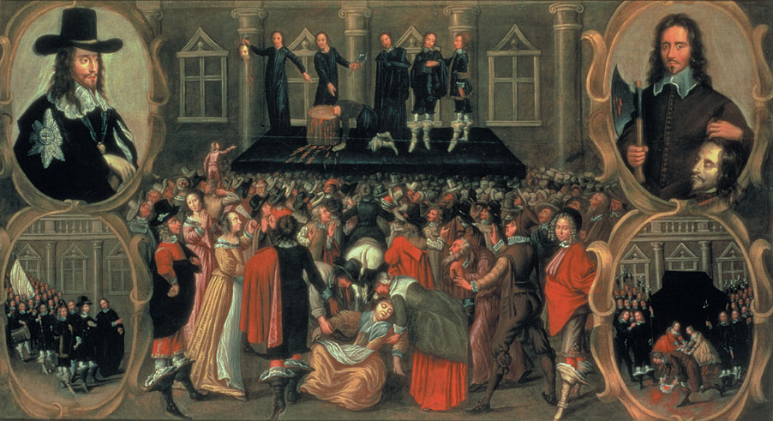
Painting of execution of Charles i
The execution of Charles I in 1649.
Give Me Liberty!: An American History, 4th Edition
Copyright © 2013 W.W. Norton & Company

Slide 55
Debate over Freedom
John Milton
freedom speech & the press in 1640s
Levellers
believed that everyone was universally entitled to freedom, not just certain social classes
Diggers
believed that freedom should be shared by the poor & rich alike
common ownership of land

Slide 56
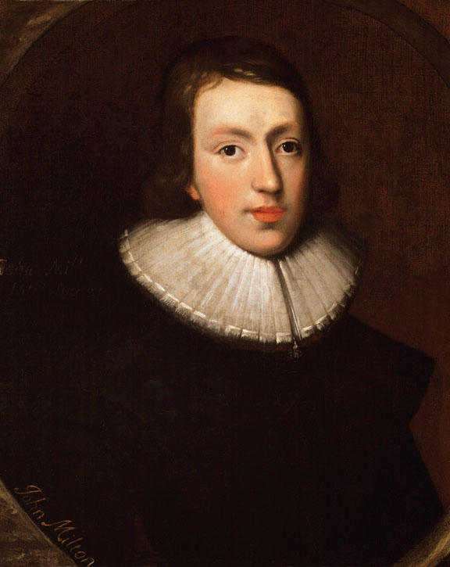
Portrait of john Milton
A 1629 portrait by John Aubrey depicts John Milton.
Give Me Liberty!: An American History, 4th Edition
Copyright © 2013 W.W. Norton & Company

Slide 57
Expansion of English Liberty
Occurred after the English Civil War
expanded to include more as serfdom disappeared and more Englishmen were considered "freeborn"
England saw itself as the world's guardian of liberty
Notes:
While most New Englanders sided with the Parliament in the 1640s, many Puritan leaders in the colonies were leery of the revolutionaries’, and the commonwealth’s, tolerance for religious dissent. When followers of Anne Hutchinson became Quakers, a radical and spiritually egalitarian Protestant sect in England that defied Puritan doctrines, Massachusetts leaders tried to suppress them by banishment, whipping, and hanging.
During the English Civil War, Virginia sided with Charles I and fell under Cromwell’s control. In Maryland, the Civil War exacerbated preexisting conflict between Catholic and Protestant settlers and anti-proprietary sentiment, feeding a civil war within that colony. Calvert stabilized Maryland and attracted more settlers by empowering Protestants in the colony’s government and guaranteeing religious toleration for all Christians.
Under Cromwell and the Commonwealth, England adopted aggressive policies to expand its colonies, promote Protestantism, and empower commerce in the British Isles and New World. Cromwell’s army extended English control in Ireland, in the process massacring civilians, banning Catholicism, and seizing Catholics’ lands. England also seized the valuable sugar island of Jamaica and passed the Navigation Acts in 1651, intended to challenge the commercial supremacy of the Dutch by limiting England’s colonial trade to English ships and ports.

Slide 58
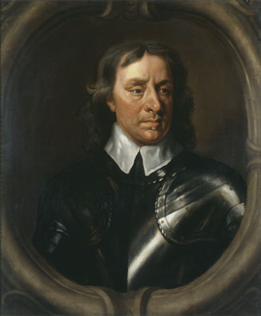
Portrait of Oliver Cromwell
Give Me Liberty!: An American History, 4th Edition
Copyright © 2013 W.W. Norton & Company

Slide 59
Expansion of Liberty in America
Parliament allowed more religious toleration with the granting of a charter to the colony of Rhode Island
made Puritans uncomfortable
Maryland erupts into a civil war
1649: Act Concerning Religion
institutionalized religious toleration
Calvert appoints a Protestant governor

Slide 60
MEDIA LINKS —— Chapter 2 ——
Title | Media link
Eric Foner on 17th-century society | http://wwnorton.com/common/mplay/6.7/?p=/college/history/foner4/&f=17th_century_society
Eric Foner on the origin of slavery in North America | http://wwnorton.com/common/mplay/6.7/?p=/college/history/foner4/mp4/&f=question018
Eric Foner on the origin of religious freedom | http://wwnorton.com/common/mplay/6.7/?p=/college/history/foner4/mp4/&f=question019
Eric Foner on religious freedom in Maryland in 1649 | http://wwnorton.com/common/mplay/6.7/?p=/college/history/foner4/mp4/&f=question020
Eric Foner on religion and American life | http://wwnorton.com/common/mplay/6.7/?p=/college/history/foner4/&f=religious_life
Notes:
Table description: The title of media and their corresponding web link.

