Slide 1
Looking West
1860-1900

Slide 2
Conflict with Native Americans
Indian Problem~ what easterners called the question over what to do with the Indians
They wanted their land
They thought they could make the land more productive

Slide 3
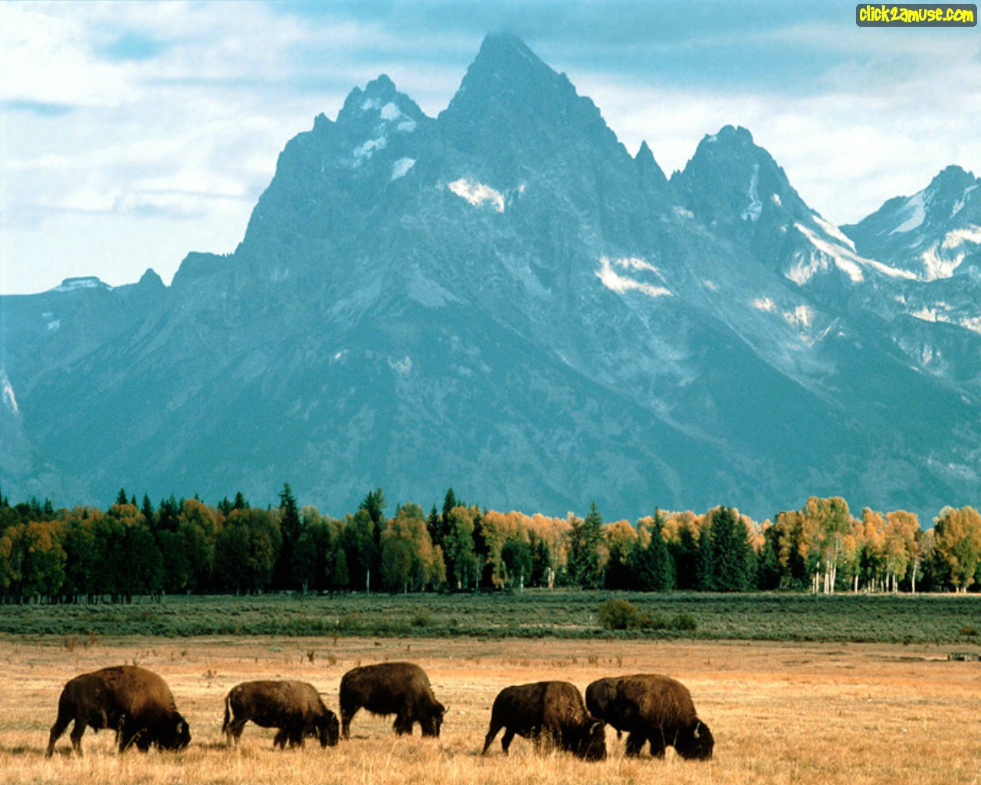
Conflict with Native Americans (cont.)
Plains Indians were mostly nomads
Buffalo (Bison) provided meat, hides, etc.
The Indians used almost everything

Slide 4
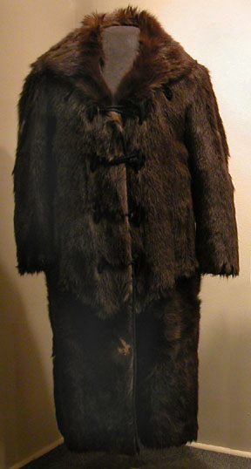
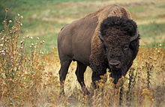
Conflict with Native Americans (cont.)
The government encouraged the destruction of the buffalo to get rid of the Indians.

Slide 5
Conflict with Native Americans (cont.)
Government signed treaties with the Indians to “exchange” their land east of the Mississippi River for land out west
Indians were simply restricted to reservations
Trail of Tears
Cherokee, Creek, Chickasaw, Seminole, & Choctaw Indians who walked from east of the MS River to land in Oklahoma
Many died b/c of starvation, disease, & exposure

Slide 6
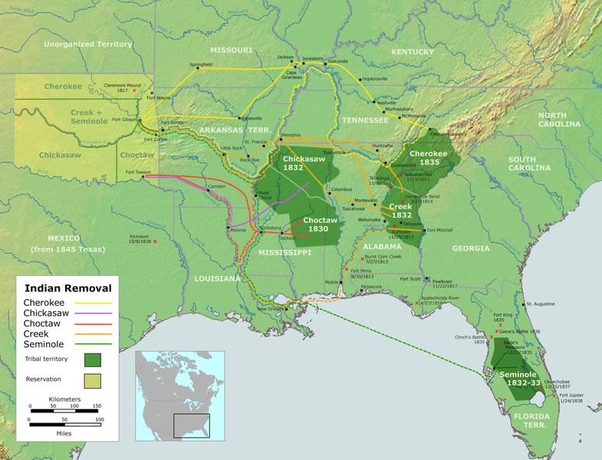

Slide 7
Conflict with Native Americans (cont.)
Federal Bureau of Indian Affairs~ corrupt & did not help them much
Acts of violence on both sides set off cycles of revenge
By the late 1800s, the gov. began to engage the Indians in fierce battles

Slide 8
Conflict with Native Americans (cont.)
Sand Creek Massacre (1864)~
Between 150-500 Cheyenne Indians were killed by Colonel John Chivington & his men
Mostly women & children present
They had been promised protection despite raids that had been conducted by Cheyenne Indians on wagon trains & settlements

Slide 9
Battle of Little Bighorn
AKA “Custer’s Last Stand”
1874 Custer & his men investigate rumors of gold in the Black Hills of the Dakotas
Gov. tries to buy the land from the Sioux they refuse

Slide 10
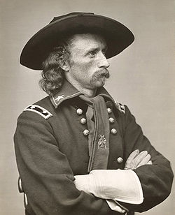

Slide 11
Battle of Little Bighorn (cont.)
1876 Custer & his men are sent to round up the Indians
They are met by over 2,000 Sioux warriors
In about one hour Custer & 200 of his men are wiped out

Slide 12
Battle of Wounded Knee (1890)
Indians on the Plains had been practicing the Ghost Dance hoping to bring back the “old days”
Teton Sioux practiced it particularly urgently
An agent at the reservation called for gov. assistance with the Indians

Slide 13
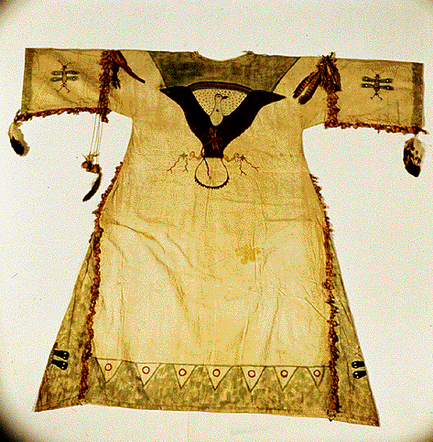
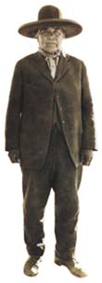
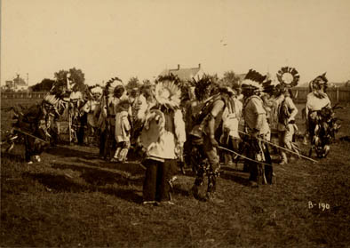
Wovoka

Slide 14
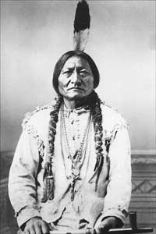
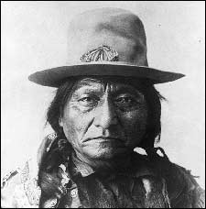
Tatanka- Iyotanka

Slide 15
Battle of Wounded Knee (1890) (cont.)
An army unit arrives & attempts to arrest Chief Sitting Bull
He resists & is shot
Later, while 120 men & 230 women and children were being rounded up, someone fired a shot
Soldiers open fire killing over 200 Sioux
After Wounded Knee, the spirit of the Indians is broken & no more major episodes of violence occur

Slide 16
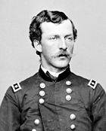
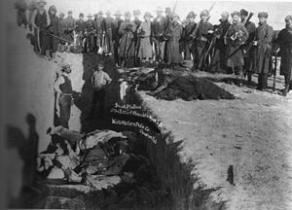
Mass Grave at Wounded Knee
Nelson Miles (sent telegram to D.C.)
Twenty Medals of
Honor were given
(highest for Army)
to soldiers who
fought there

Slide 17
New government policies
Tried to “civilize” them, or get them to adopt white customs & traditions
AKA assimilation
Took children to raise “as Americans” and make them more like white settlers

Slide 18
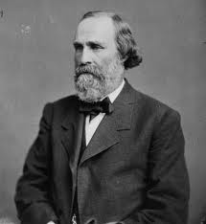
New government policies (cont.)
***Dawes Act (1887)~ divided reservation land into individual plots of 160 acres each
Attempted to rid the Native Americans of the concept of shared land and instill the idea of private property

Slide 19
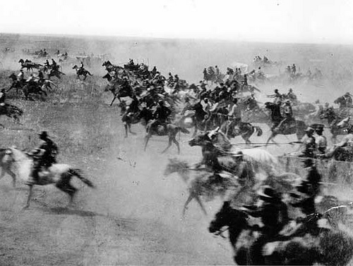
New government policies (cont.)
Indian Territory (Oklahoma) was opened up to settlement b/c Indians would not/could not farm the land
They were often swindled out of it
Oklahoma Land Rush
April 22, 1889: tens of thousands of homesteaders line up at the border of Indian Territory to stake claims

Slide 20
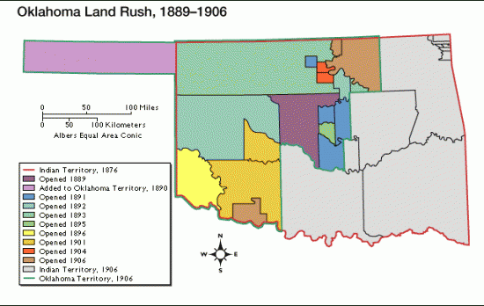

Slide 21
New government policies (cont.)
Boomers~ settlers who engaged in the race for land in Indian Territory
Sooners~ people who illegally claimed land before the land race began

Slide 22
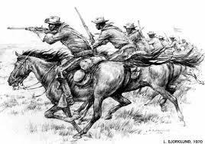
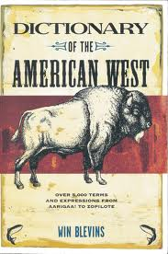
Lure of the West
Seized the American imagination
Kindled sense of adventure & entrepreneurial spirit
Appealed to their appetite for profit & conquest

Slide 23
Lure of the West
Conditions that pushed people West:
Farmland was cheaper
People sought a second chance
Escape from oppression
Escape from the law

Slide 24
Lure of the West
Government incentives to go West:
Pacific Railway Acts of 1862 & 1864
Gave large amounts of land to the Union Pacific & Central Pacific Railroads
Railroads sold extra lands to settlers for a profit

Slide 25
Lure of the West
Morrill Land Grant Act of 1862
Gave state governments millions of acres which they could sell to raise money for the creation of “land grant” colleges for agriculture & technical arts

Slide 26
Lure of the West
Homestead Act of 1862
For a small fee, settlers could receive 160 acres of land
Requirements:
21 years old or the head of the family
American citizen
Build a house at least 12x14 feet
Live there 6 months in the year
Farm it for 5 years in a row

Slide 27
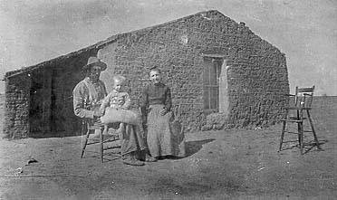

Slide 28
Lure of the West
Private property
Key incentive was the availability of legally enforceable property rights
Cheap land attracted people of other countries & ethnic groups

Slide 29
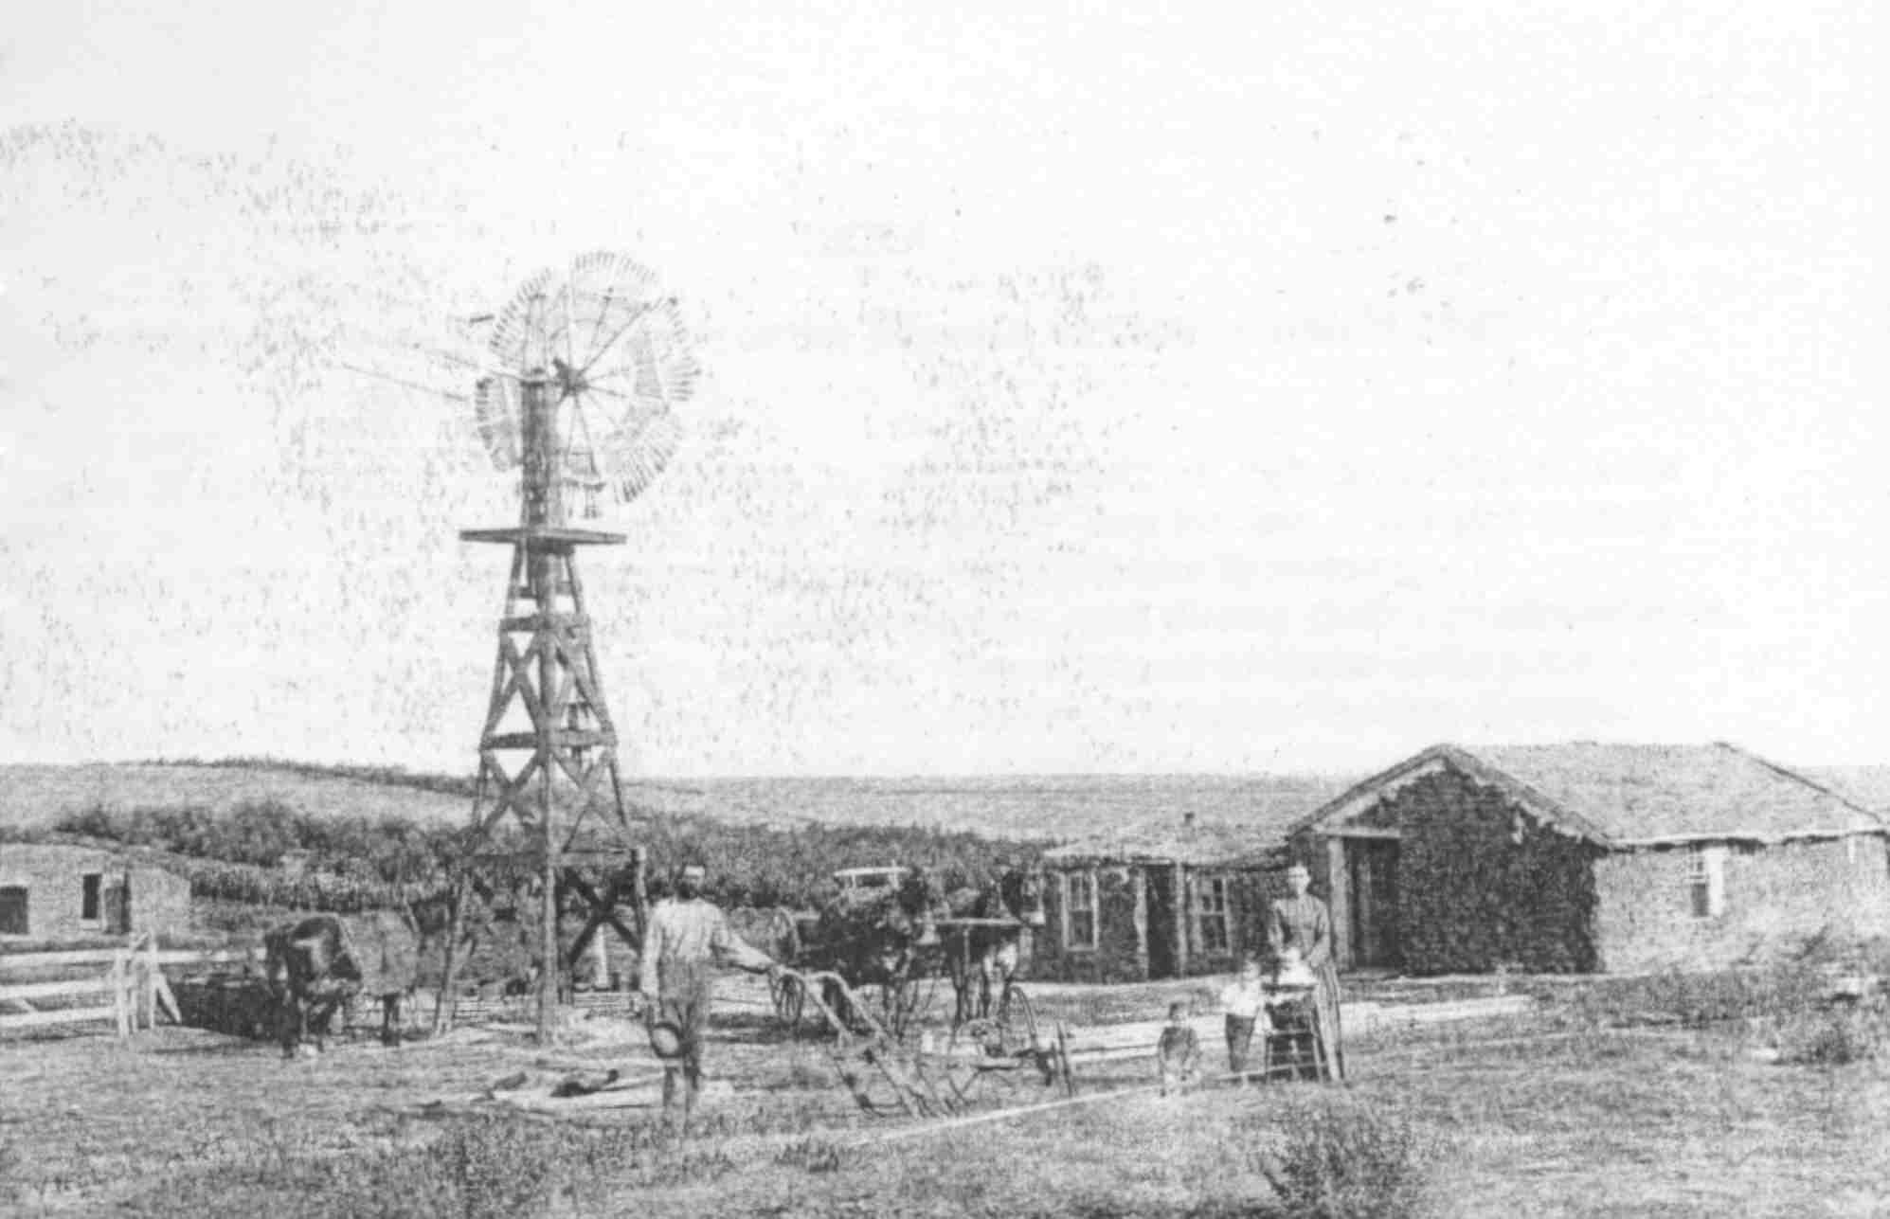

Slide 30
Lure of the West
Settlers of the West
German immigrants settled along the Great Plains
Brought with them the Lutheran religion & a commitment to hard work and education

Slide 31
Lure of the West
Irish, Italians, European Jews, and the Chinese tended to settle in concentrated communities in the cities
Mexican Americans contributed to the growth of ranching

Slide 32
Lure of the West
Exodusters
African Americans that left the South to go West after the Civil War seeking freedom from oppression
Led in 1879 by Benjamin “Pap” Singleton

Slide 33
Lure of the West
Various regions were settled at different times, but by 1890 settlements dotted the prairies every 10 miles or so.

Slide 34
Mining and Ranching
The discovery of gold in the mid-1800s sent many people west
Many mining towns in which there were large claims of gold grew into big cities
Example= San Francisco

Slide 35
Mining and Ranching
After the Civil War, Texans founded ranches & rounded up cattle herds
Learned ranching from Mexicans in early 1800s

Slide 36
Mining and Ranching
Chisholm Trail
Cowboys drove cattle from South Texas north to major railway centers
From the railway centers cows were shipped east to major meatpacking centers
Ex= Chicago, IL & St. Louis, MO

Slide 37
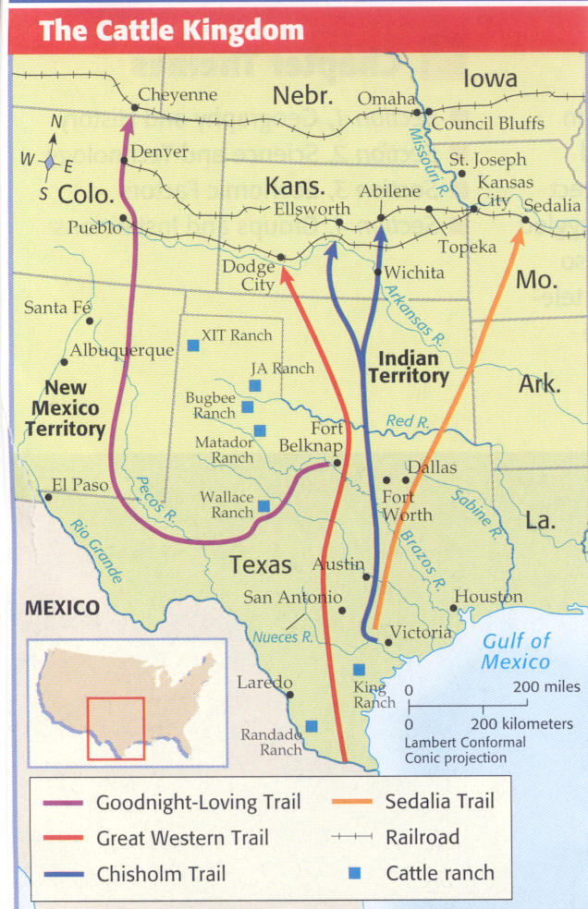

Slide 38
Mining and Ranching
Cowboys
Included Americans, Native Americans, immigrants, African Americans, & Mexicans
Survived by sheer physical endurance on a ride that was bone-tiring & mostly dull
Could spend up to 18 hours a day in the saddle

Slide 39
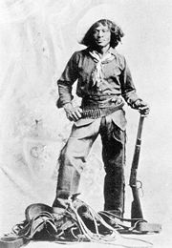
Nat Love
African American Cowboy

Slide 40
Mining and Ranching
By the mid-1880 cattle expansion ended due to over-expansion, price declines, cold winters, dry summers, & cattle fever drove many into bankruptcy
Joseph Glidden invented barbed wire in 1874
Contributed further to the closure of the open range

Slide 41
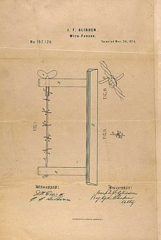
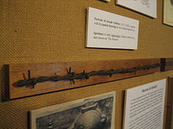
Joseph Glidden’s patent drawing & original Glidden wire

Slide 42
Homestead Life
Most houses were made of sod or dug out of an embankment
Sodbusting = plowing the fields for planting
Floods, fires, duststorms, drought, grasshoppers, bollweevils, locusts, mosquitoes, & flies could wreck harvests & cause misery

Slide 43
Homestead Life
Falling crop prices led to farmer debt
Many homesteaders had to return east
Lacked skill to hold onto claim for five years
Everyone had to work at many tasks to make the farm successful

Slide 44
Homestead Life
New Inventions that helped farmers:
Barbed wire
Mechanized reaper
Dry farming (drought resistant crops & other techniques used to reduce evaporation)
Steel plow
*Bonanza farms~ large farms that were the forerunners of the commercial farms

Slide 45
Frontier Myths
The frontier had to be tamed
Churches, social clubs, & governments could be found out West
Reality: it was not as wild as it seemed

Slide 46
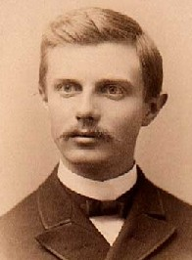
Frontier Myths
Turner’s Frontier Thesis
Claimed that “taming the west” had led to the unique American individuality and ingenuity
He overlooked the contributions of minorities b/c he attributed the “taming of the west” only to white settlers

Slide 47
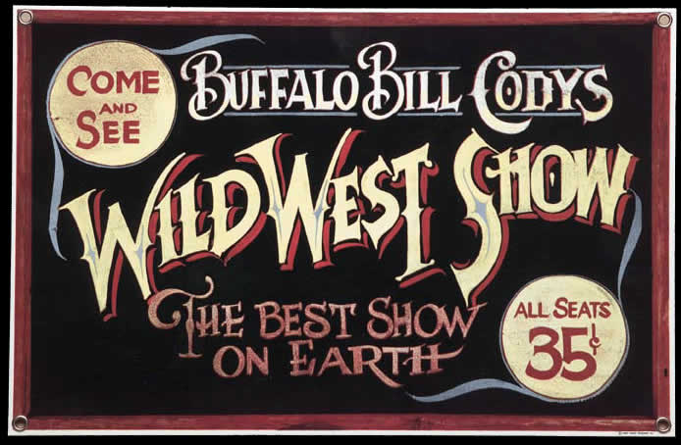
Frontier Myths
Literature, Songs, & Shows
Stories often promote stereotypes, or exaggerated or oversimplified versions of reality
Buffalo Bill Cody’s Wild West Shows did this by staging drama between “good” soldiers/cowboys and “bad” Indians

Slide 48
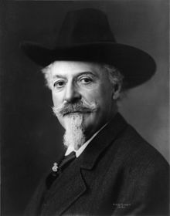
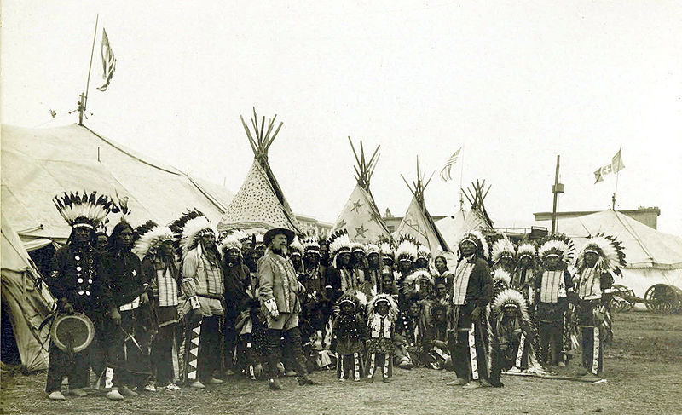
William Cody

Slide 49
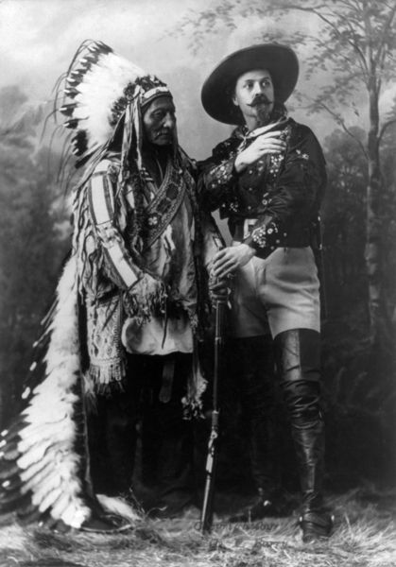
Sitting Bull & Cody

Slide 50
Populism
Late 1800s, farm production had risen as a result of new technology
Farmers’ debt had risen also
When crop prices decreased, farmers could not repay their loans
1873 & 1893 the nation went into financial panics
Businesses go bankrupt
Banks fail

Slide 51
Populism
Tariff = tax on imported goods
They raise the price on foreign goods in a country to encourage people to buy items made in their own country
Tariffs hurt farmers however because they often ship goods overseas
When the U.S. raised its tariffs, many other countries raised theirs in retaliation. This raised the price of the farmers’ goods
Tariffs favored U.S. industrialists

Slide 52
Populism
Farmers wanted the government to increase the amount of money in circulation
This would cause inflation, or a rise in prices. Inflation benefited farmers b/c they receive more money for their crops

Slide 53
Populism
Gold bugs v. Silverites
1873: the nation is put on the gold standard
Before this, money was either gold or silver or paper money that could be exchanged for either.
Gold bugs = lenders
Wanted gold standard b/c it would cause deflation
Meant that the money paid back to them was worth more than the money leant out

Slide 54
Populism
Silverites = farmers
Wanted the nation’s currency to be backed by silver b/c it is more plentiful
Silver backed currency meant an increase in the amount of money in circulation, which causes inflation

Slide 55
Populism
Bland-Allison Act 1878~ required the government to purchase & coin more silver thereby increasing the money supply
Sherman Silver Purchase Act 1890~ Increased the amount of silver the gov. was required to purchase
Repealed in 1893.
This act was blamed for the financial panic that year

Slide 56
Populism
1866 Farmers created the Patrons of Husbandry or the Grange
Farms bought goods in bulk at lower prices
Pressured government to regulate businesses that farmers relied on such as the railroads

Slide 57
Populism
Farmers’ Alliances
Formed to fight businesses that took advantage of farmers
Included women & African Americans in their leadership

Slide 58
Populism
1887: Texas Seed Bill~
Provided seed to drought victims
Vetoed by the President
1887: Interstate Commerce Act
Set up the Interstate Commerce Commission to regulate railroads
Outlawed the practice of giving special rates
Significant expansion of gov. authority

Slide 59
Populism
1891: Farmers’ Alliances form the People’s Party
AKA Populist Party
Platform (central issues)
Unlimited minting of silver
Progressive income tax
Gov. ownership of communication & transportation systems

Slide 60
Legacy of Populism
Many of their ideas became reforms in the 20th century
Underserved people learned that they could organize and successfully fight unfair government and business practices

Slide 61
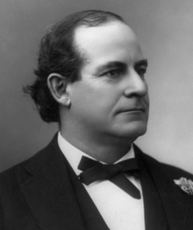
William Jennings Bryan
1896 Democratic Party Candidate
Captured the nomination by his powerful “Cross of Gold” speech
Lost to William McKinley
Bryan carried the west & south, but none of the urban, industrial areas

Slide 62
