Slide 1
The Progressive Era
1890-1920

Slide 2
Origins
Grew out of earlier reform groups
  Populists, nativists, purity crusades, social gospel, etc.
Reacting to:
  Rapid industrialization
  Immigration
  Urbanization

Slide 3
It was not a single, organized movement
  Four main categories of reformers
    Social
    Moral
    Economic
    Political
  Not all groups agreed on what should be accomplished

Slide 4
Most held in common four basic beliefs:
1. Government should be more accountable
2. Government should curb the power of wealthy businesses
3. Government should be given expanded powers to be more active in improving peoples’ lives
4. Government should become more efficient & less corrupt

Slide 5
Igniting Reform
Journalists and other writers greatly influenced reform
Journalists who wrote of wrongdoing to uncover scandal & corruption were known as muckrakers
  Term coined by Teddy Roosevelt

Slide 6
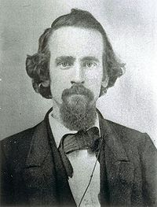
Henry George
1879: Progress & Poverty
  He thought poverty arose because some people bought & held onto land until the price went up
  Believed that the government should charge a tax for holding the land, not just for improvements

Slide 7
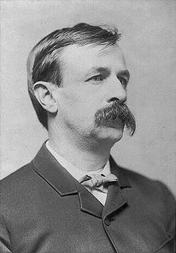
Edward Bellamy
1888: Looking Backward
In 1897, a man undergoes hypnosis and wakes up in the year 2000 where there is no longer any poverty, corruption, etc.

Slide 8
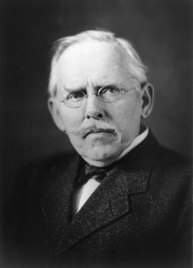
Jacob Riis
1890: How the Other Half Lives
  Told of the terrible conditions in the tenements, or apartment buildings in New York City
  Book also contained photographs of
  life in the tenements

Slide 9
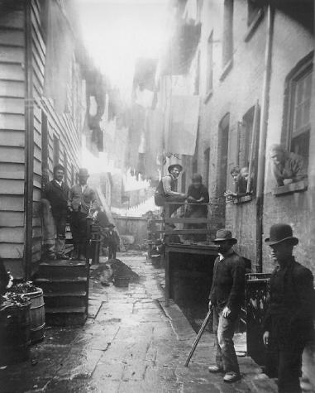
Bandit’s Roost at Mulberry Street
Bandit’s Roost
was considered the
most crime ridden
part of New York

Slide 10
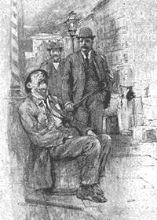
Cartoon showing TR walking the beat in New York City as Police Commissioner with Jacob Riis

Slide 11
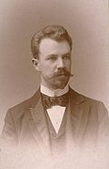
Lincoln Steffens
1904: The Shame of the Cities
Exposed political corruption in St. Louis & other cities

Slide 12
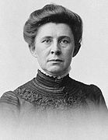
Ida Tarbell
1904: The History of the Standard Oil Company
Exposed the corrupt business practices of the Standard Oil Company & John D. Rockefeller

Slide 13
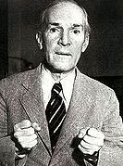

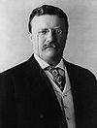
Upton Sinclair
1906: The Jungle
Exposed the violent accidents, horrible illnesses, and painful deaths of workers in the meatpacking industry
Also exposed the sickening way meat found its way to the American dinner table
  Teddy Roosevelt read it and promised reform

Slide 14
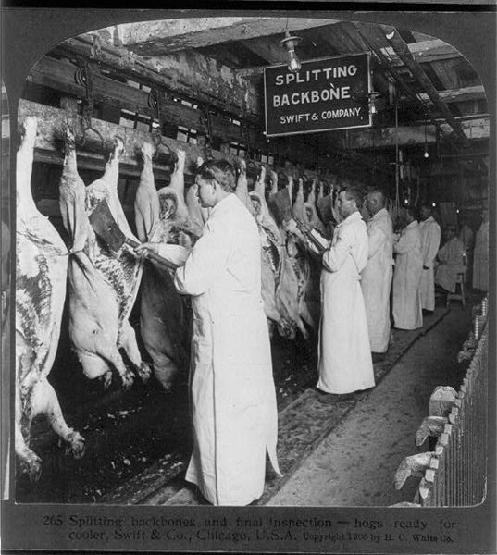

Slide 15
Upton Sinclair
The Jungle was the inspiration for reforms such as:
  Pure Food and Drug Act
    Set up the FDA or Food and Drug Administration
  Meat Inspection Act
    Set up the USDA or United States Dept. of Agriculture
  These laws required:
    the accurate labeling of ingredients
    strict sanitary conditions
    a rating system for meats

Slide 16
Others:
Nellie Bly in 1890 published Ten Days in a Mad House exposing the horrible treatment of the mentally ill
  Sometimes considered the original muckraker
David Graham Phillips' Cosmopolitan article, "The Treason of the Senate," a bitter indictment of political corruption, provoked President Roosevelt's wrath, but created momentum that would to the adoption of the 17th Amendment
Ray Stannard Baker examined the sad state of race relations in America in Following the Color Line (1908)

Slide 17
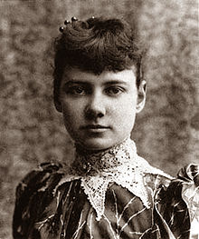
Nellie Bly

Slide 18
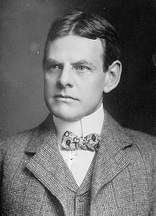
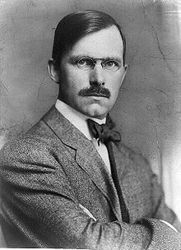
David Graham Phillips
Ray Stannard Baker

Slide 19
Women’s Groups
Rose to new levels of civic activism in the Progressive Era
National Consumer’s League (NCL)
  Founded to investigate conditions in which goods were made & sold
  Women played a vital role in helping to investigate
  Goals = Factory inspection laws & minimum wage laws

Slide 20
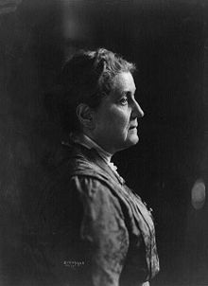
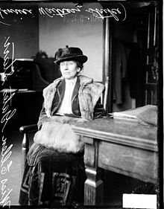
Hull House
Founded in 1889 by Jane Addams & Ellen Gates Starr in Chicago, Illinois
A settlement house, it was intended to provide social & educational opportunities to immigrants & other poor in society

Slide 21
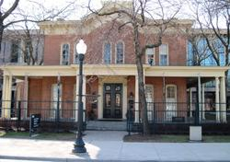
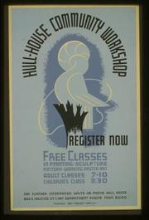
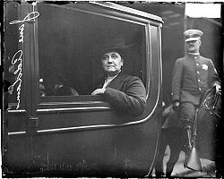

Slide 22
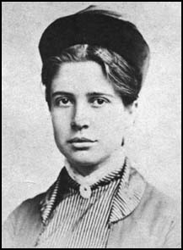
Florence Kelley
Joined Hull House in 1891
She was recommended by Jane Addams to investigate local labor conditions in Chicago
  Successfully saw child labor laws, limited working hour laws for women, & other laws regulating the conditions in factories passed
  When the district attorney refused to prosecute companies who broke the laws, she earned a law degree to be able to prosecute them herself

Slide 23
Mother Jones
1867: Her family dies in a yellow fever epidemic in Tennessee
She rebuilt her life, establishing a successful dressmaking business in Chicago
  1871: she lost everything in the Great Chicago Fire

Slide 24
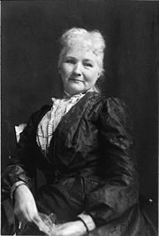

Mother Jones
Worked with the Knights of Labor & other unions to improve workplace conditions
1905: she helped to found the Industrial Workers of the World (IWW)

Slide 25
Resistance to Reforms
Many people resented the increased involvement in their lives that many reforms would / did bring
Most families needed the income their children provided to live, and Progressives wanted to get rid of child labor
  Many thought Progressives were insensitive to the poor

Slide 26
Progressive Legislation
Progressives believed that the government ought to increase its responsibility for the welfare, or well-being, of its people
  They sought the passage of social welfare programs to ensure a minimum standard of living
  Unemployment benefits, accident & health insurance, & social security system for disabled & elderly

Slide 27
  Municipal Reforms
    Worked for home-rule, a system that gave cities a degree of self-rule so that they could escape the domination of state governments controlled by political machines or business or rural interests.
    Most political machines and bosses survived attacks on them.
      In some cities, however, voter support for reforms prompted machine politicians to work with reformers. Together they improved city services, established public health programs and workplace reforms, and enforced tenement codes.

Slide 28
    Reformers made efforts to regulate or dislodge monopolies that provided city utilities such as water, gas, and electricity.
      By 1915, two out of three cities had some city-owned utilities.
    City-supported welfare services were supported by many
      Examples include public baths, parks, work relief programs, playgrounds, free kindergartens, and lodging houses for the homeless.
      In many peoples’ view, all people could become good citizens if the social conditions were good

Slide 29
    Catastrophes such as the Triangle Shirtwaist Fire also helped to bring about reforms
      146 workers died in the fire that broke out in 1911 in New York City
      The exits were locked; those that were unlocked led to the roof where people jumped into firemen’s nets that broke (the ladders were not long enough to reach the top of the building).
        Those that managed to get to a rusted fire escape plunged to their deaths as it broke
    Reforms that resulted:
      fire inspectors, mandatory fire drills, unlocked & fireproofed exits, and automatic sprinklers in buildings more than seven stories high

Slide 30
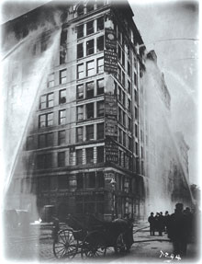

Slide 31
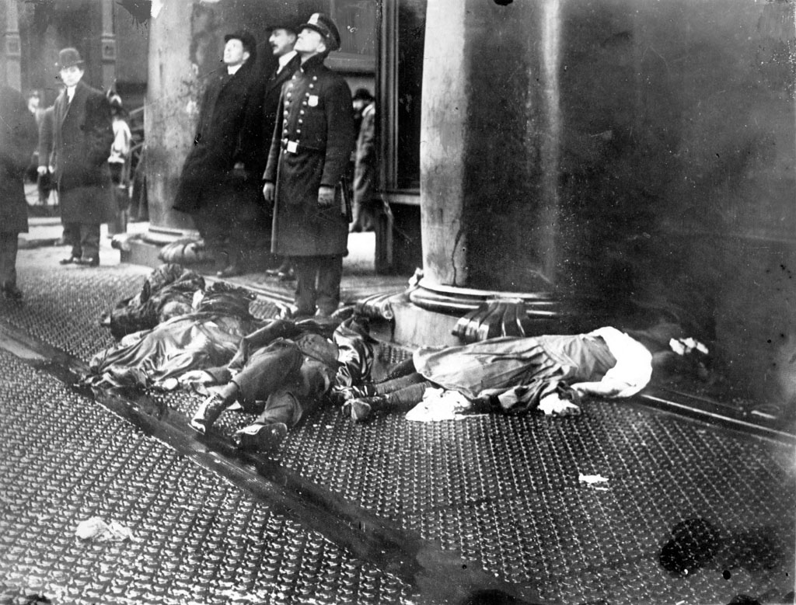
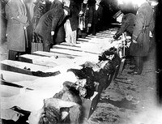

Slide 32
  State Reforms
    One major trend = shift of power towards the voters. People had more direct say in government
      Direct primary: an election in which citizens vote to select nominees for upcoming elections instead of the nominees being picked by party leaders in shady “back room” deals.
      Initiative: Citizens can propose a new law directly on the ballot in the next election by collecting voters’ signatures on a petition.

Slide 33
      Referendum: Allows citizens to approve or reject a law passed by the legislature. This if found on the ballot at election time.
      Recall: Allows citizens to remove public officials from office before the next election.
      17th Amendment: Required the direct election of senators instead of them being chosen by state legislatures (1913).

Slide 34
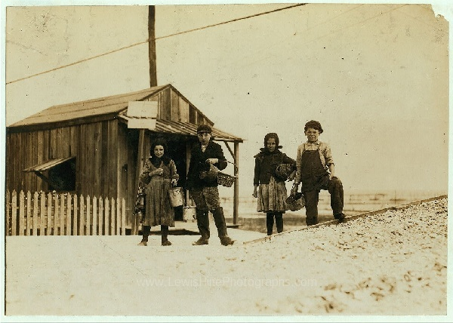
Pass Christian, Mississippi
    Minimum wage laws, child labor laws, and laws that set maximum hours were successfully passed in some states, but there also were some difficulties in keeping them.

Slide 35
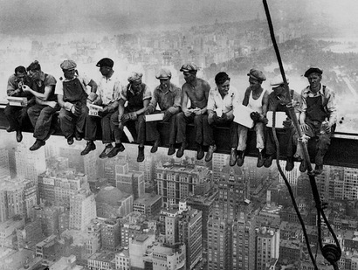
Empire State Building Workers

Slide 36
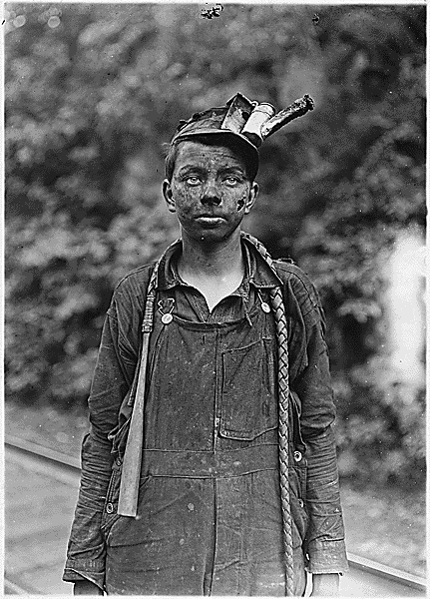
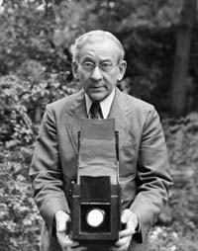
Lewis Hine

Slide 37
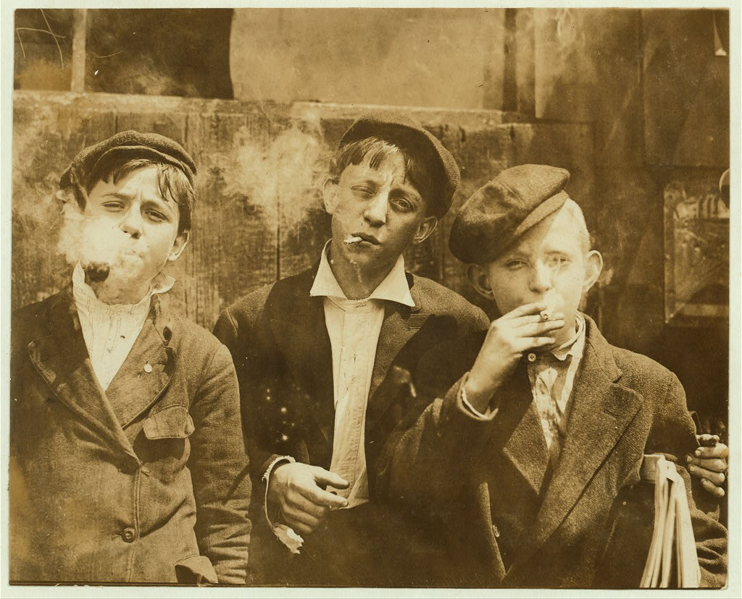
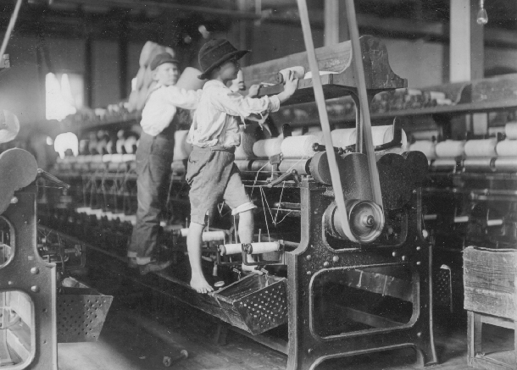

Slide 38
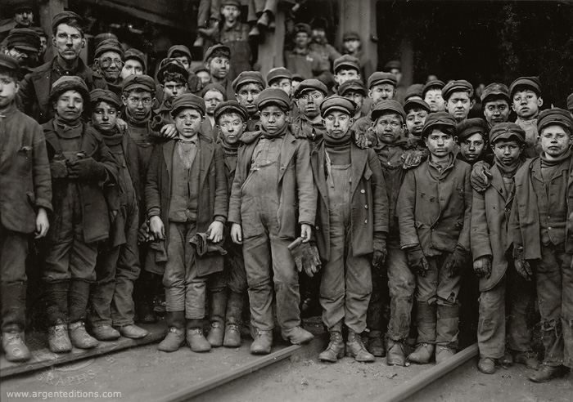
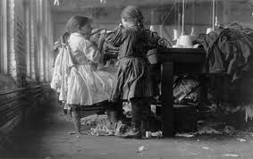

Slide 39
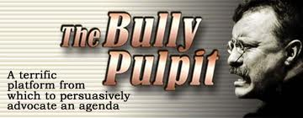
Federal Reforms
    Beginning in 1901, the White House became a powerful voice for change
      Teddy Roosevelt was the first president to use the position as a “bully pulpit.” This is an ideal platform from which to guide or rally the American public to support moral, worthy causes.
        In this, he created the modern presidency in which the chief executive is a strong political force.

Slide 40
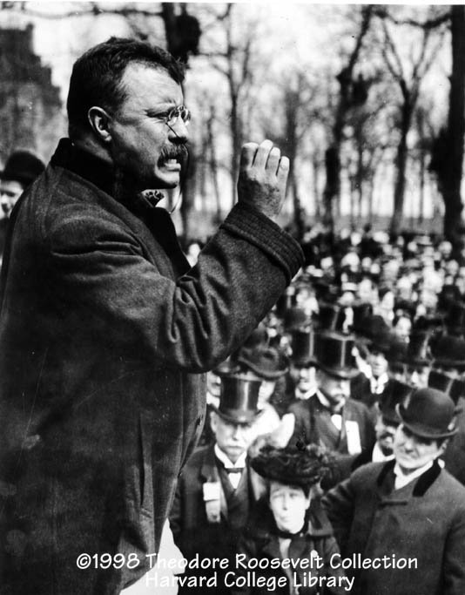

Slide 41
    Square Deal
      1902, the United Mine Workers called a strike to protest low wages
        Winter approached and the union and owners were not close to a deal
        TR decided to act because without a solution, the nation would be facing shortage of an important source of heating fuel
          He insisted that each side submit to arbitration, or where an impartial third party decides on a legally binding solution.
            He threatened to use the army to seize and operate the mines

Slide 42
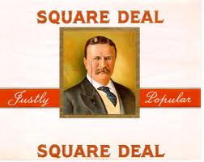
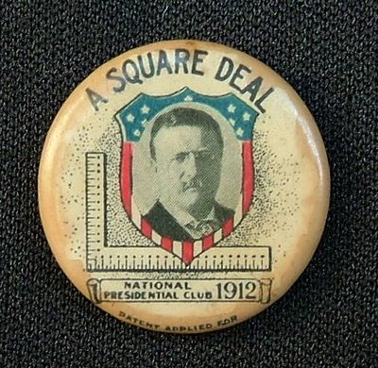
          1903, the arbitrators decided to give the miners a 10% raise and reduce the workday from 10 hours to 9
            The arbitrators did not officially recognize the union
          When Roosevelt called this a “square deal” for both sides in the coal strike, the phrase became a slogan of his presidency.

Slide 43
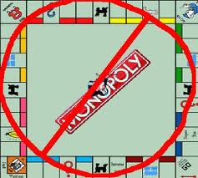
    Trust Busting
      The Sherman Antitrust Act which was in place by 1890 was not effective on monopolies & never well enforced.
      Teddy Roosevelt began to enforce the act
        Northern Securities Company dissolved by the Supreme Court in 1904.

Slide 44
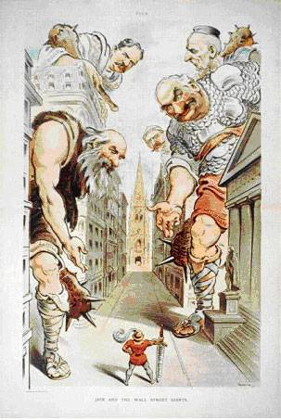

Slide 45
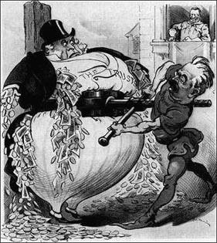
      TR filed 44 antitrust actions.
        The beef trust, Standard Oil, and the American Tobacco Company were either broken up or forced to reorganize
        TR did not want to destroy trusts that did not harm the public
          Thought the federal government should regulate them.

Slide 46
Railroad Regulation
      In 1906, Congress to passes the Hepburn Act.
        The Hepburn Act moved the Interstate Commerce Commission (ICC) out of its largely weak advisory role and gave it strong enforcement powers.
          It authorized the ICC to set and limit railroad rates.
          The ICC became the first true federal regulatory agency.

Slide 47
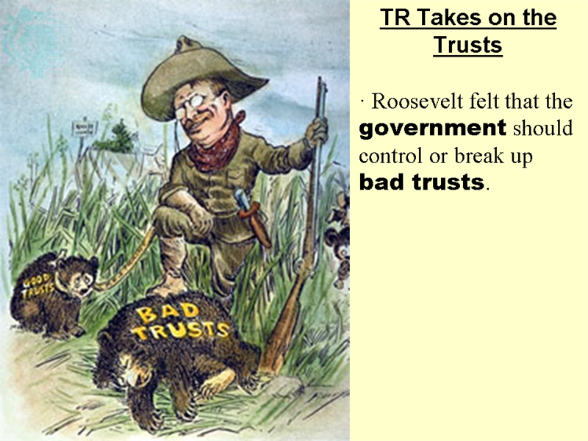

Slide 48
Labor Department
      1912 a Children’s Bureau was established
      1920 a Women’s Bureau was created
        Both of the bureaus supported laws benefiting women and children
        Both were a part of the Department of Labor

Slide 49
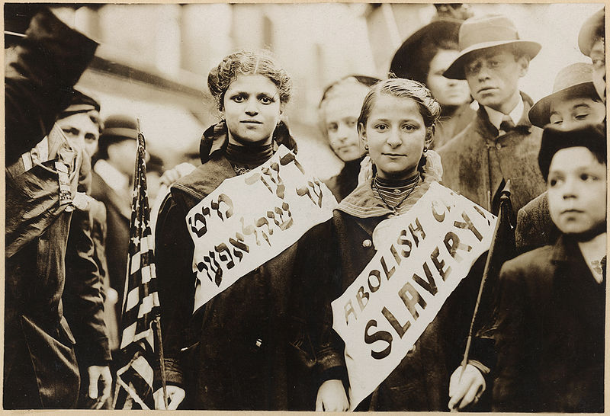
Girls protesting child labor

Slide 50
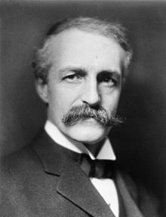
Conservationism
      TR urged Congress to take steps to protect the nation’s natural resources
      Presidents Harrison and Cleveland had preserved 35 million acres
      1905, TR named Gifford Pinchot to head a newly created United States Forest Service
        Pinchot and TR together preserved more than 200 million acres for national forests, mineral reserves, and water projects
      National Reclamation Act passed in 1902 used money from the sale of public lands to build irrigation systems in arid states to allow the land to be used for farming.

Slide 51
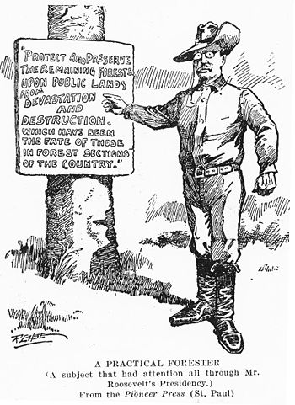

Slide 52
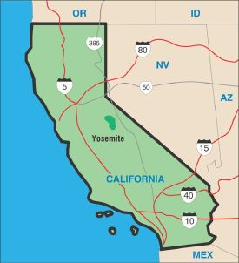
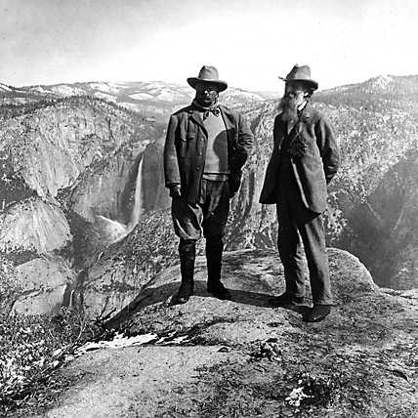
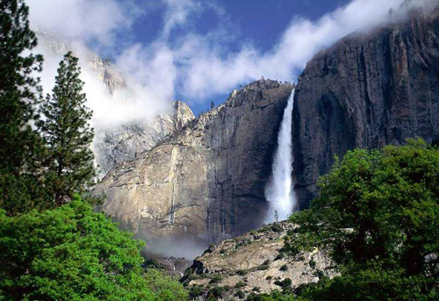
T.R. & John Muir at Glacier Point in Yosemite National Park, 1903

Slide 53
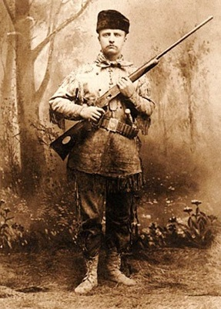
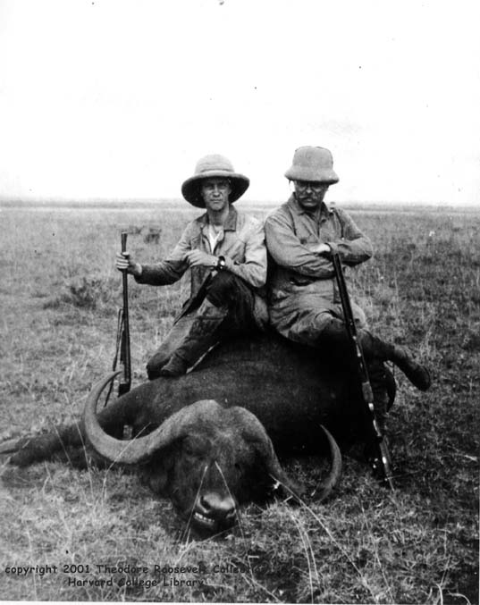

Slide 54

New Amendments
      16th Amendment: authorized the federal government to collect income taxes
      17th Amendment: required the direct election of Senators
      18th Amendment: banned the production, sale, or distribution of alcoholic beverages
        many thought that it would protect society from the poverty and violence associated with drinking.

Slide 55
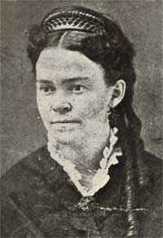
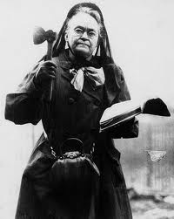
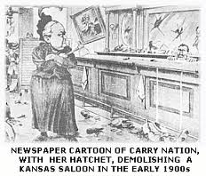
Carry Nation

Slide 56

Progressivism under Taft
  In the Presidential election of 1908, Taft easily won over William Jennings Bryan.
    TR, who was very popular, backed Taft and essentially hand-picked him to be the next president.

Slide 57


Slide 58


Slide 59




Slide 60
  Conflict over Tariffs
    Taft was supposed to support Progressives goals much as TR had, but he ended up angering and alienating the Progressives
    The Payne-Aldrich Tariff passed in 1909 which raised tariff rates, angered the Progressives
      Most Progressives were against raising tariff rates since they felt that it raised the price of goods that the poor had to buy

Slide 61


Slide 62


Slide 63

  Ballinger-Pinchot Affair
    Taft chose Richard A. Ballinger for the Secretary of the Interior post
      This angered conservationists because Ballinger opposed conservationist policies on federal lands in the West, siding with business interests that sought unrestricted development
      Ballinger was in conflict with TR-appointed Pinchot, head of the Forest Service
      1909 it became known that Ballinger gave several million acres of Alaskan public lands containing rich coal deposits to private business companies

Slide 64
        Pinchot charged that Ballinger had been shown special preference
        Taft fired Pinchot when he began to try to get Ballinger investigated on corruption charges
        Ballinger was never found guilty of wrongdoing, but he eventually resigned
        Pinchot remained a public hero, and Taft’s popularity continued to decline.

Slide 65
  Divisions in the Republican Party
    TR aggressively campaigned for Progressive candidates in the 1910 midterm elections
      He called for business regulation, welfare laws, workplace protection for women and children, income and inheritance taxes, and voting reform. TR called this plan New Nationalism.

Slide 66

Election of 1912
  Roosevelt challenged Taft for the Republican nomination for the 1912 election
    Taft nominated for the Republican Party

Slide 67



  Bull Moose Party
    Platform (Issues they supported)
      Tariff reduction
      Women’s suffrage
      More regulation of business
      A child labor ban
      An eight-hour workday
      Federal worker’s compensation system
      Direct election of senators

Slide 68


Slide 69


Slide 70



    Roosevelt ran a vigorous campaign. On Oct. 14, 1912, at a speech in Milwaukee, Wisconsin, TR was shot by a would-be assassin
      With a bullet lodged in his lung, he spoke for an hour and a half before seeking medical aid.

Slide 71

  Taft’s Record
    reserved more public lands & brought more antitrust suits in four years than TR had in seven.
    Taft supported the Children’s Bureau, the Sixteenth and Seventeenth Amendments, and the Mann-Elkins Act of 1910.
      This act gave the ICC the power to regulate telephone and telegraph rates

Slide 72
  Wilson’s New Freedom
    Woodrow Wilson chosen to head the Democratic Party.
    Wilson, like TR, ran on a reform platform, but unlike TR he criticized both big business and big government.
      As part of his New Freedom policy, Wilson promised to enforce antitrust laws without threatening economic competition

Slide 73

  Four main candidates sought the presidency in 1912
    Republican= Taft
    Bull Moose Progressives= Roosevelt
    Democratic= Wilson
    Socialists= Eugene V. Debs
  With the Republican vote split between Taft and Roosevelt, Wilson emerged the winner
Democrats also took control of both houses of Congress

Slide 74


Slide 75

Wilson as President
  Tariff reduction was his first major victory
    Underwood Tariff Act of 1913 reduced average rates from 40% to 25%
    To make up for the lost revenue, Wilson signed into law a federal income tax, made legal by the Sixteenth Amendment

Slide 76

  Clayton Antitrust Act passed in 1914 continued to attack trusts by spelling out the specifics that businesses could and could not do
    The Federal Trade Commission (FTC) was set up to enforce the Clayton Antitrust Act

Slide 77
  Federal Reserve System
    Set up by the Owen-Glass Federal Reserve Act of 1913
      Divided the country into 12 districts, each with its own Federal Reserve bank owned by its member banks
      System was supervised by a Federal Reserve Board appointed by the President
      System was intended to help prevent bank failures that occurred when large numbers of depositors withdrew funds during an economic panic

Slide 78


Slide 79

  Wilson nominated Louis D. Brandeis to the Supreme Court in 1916
    First Jewish Supreme Court nominee
    The appointment of Brandeis marked a peak of federal progressive reforms
  Wilson wins reelection in 1916 on the slogan “He kept us out of the war”

Slide 80
Limits of Progressivism
  People not helped by Progressives
    Tenant or migrant farmers
    Nonunionized workers
  Many supported immigration limits and literacy tests
  Wilson allowed Jim Crow practices such as segregation to be practiced in federal buildings
    He did very little to support African American rights
  Wilson initially opposed an amendment for women’s suffrage

Slide 81
Women’s Suffrage
  Arguments Against It
    unnecessary
    threat to the stability of American society & government
      easily manipulated by politicians
    become too masculine
    distract them from duties at home
    did not want to vote

Slide 82



Slide 83
  American women first formally demanded the right in 1848 at the Seneca Falls Convention in New York
  Women such as Susan B. Anthony led a group of women to the polls in 1872 to demand to be able to vote
    Anthony and others were arrested for this act of civil disobedience

Slide 84



Slide 85
  Women’s involvement in WWI convinced many that women deserved the right to vote
  1920 the Nineteenth Amendment was passed in which women were given the right to vote
    This marked the last major reform of the Progressive Era

